Slide 1

3. In Situ Measurements at L1
James Marshall, SWFO PGD science team
Notes:
Good morning, my name is ____ and I am a scientist in the Ground Segment of the SWFO project.
This talk will cover in situ measurements from NOAA by SWFO and DSCOVR instruments and NASA operationally-used datasets.

Slide 2
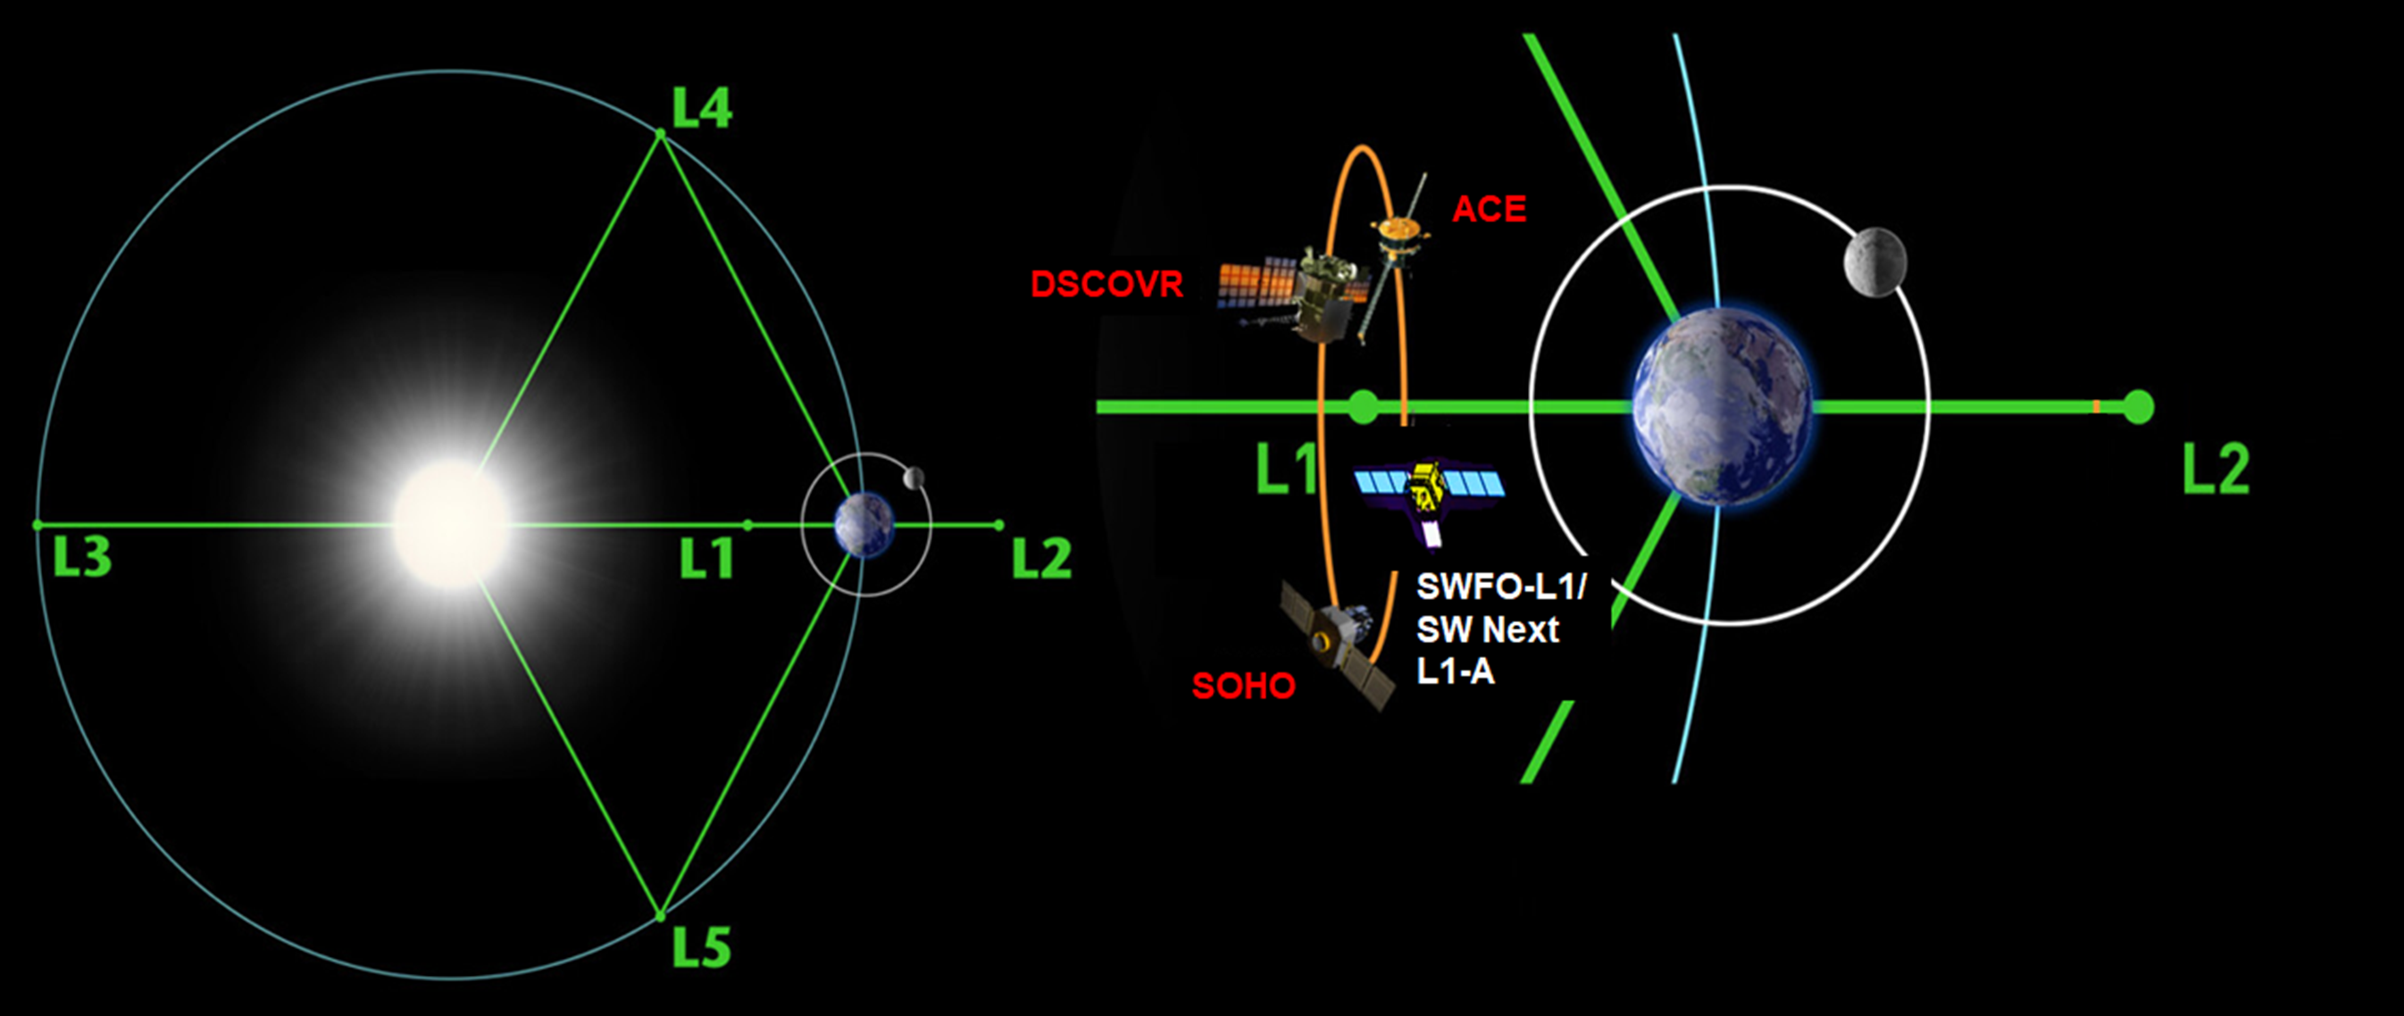
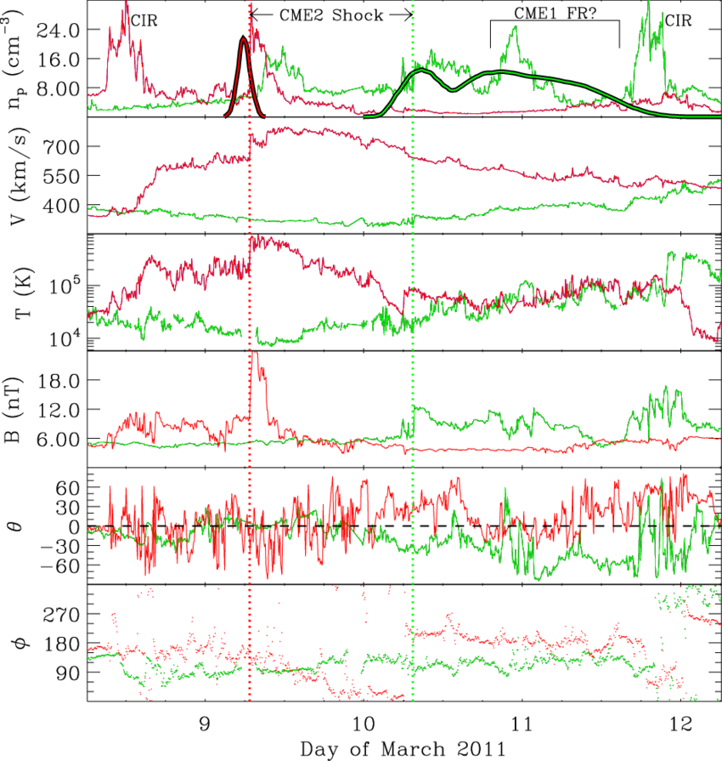
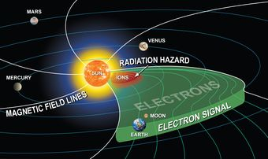
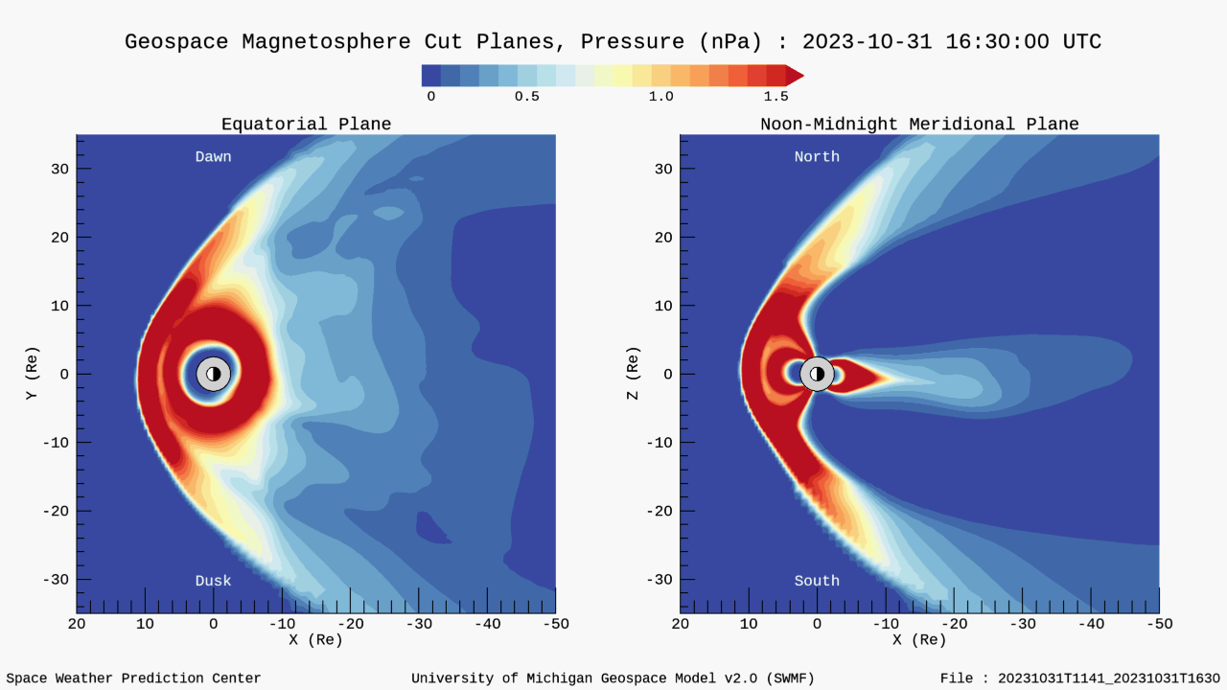
Objectives and Significance
The objectives for measuring solar wind, particle flux, and IMF at a location upstream of Earth such as the Sun-Earth Lagrange 1 (L1) point are several:
Operational:
  Quantify the state of the solar wind
  Drive real-time NWP models
  Develop watches/warnings for damaging SEP events and geomagnetic storms
Retrospective/science:
  Validate and improve research models
  Make progress towards long-standing plasma physics problems such as reconnection and solar wind turbulence
  Apply statistical techniques including AI/ML
The solar wind plasma velocity and the IMF at L1 are two Key Performance Parameters (KPPs) for SWFO, and also important for future programs.
High-level requirements (SWFO):
  Latency (difference between time of observation and time of availability to the user): < 5 min
  Availability: > 96%.
GEO
Solar wind/IMF regimes
Suprathermal electrons
Geospace 2.0: a NWP model run at SWPC
Notes:
The objective for measuring solar wind, the IMF [interplanetary magnetic field], and particle populations at a location upstream from Earth are multiple:
Operationally
Quantify the state of the solar wind
Provide alerts for destructive SEPs [solar energetic particles]
Drive real-time numerical weather prediction (NWP) models
Science
Improve research models
Make progress towards long-standing problems such as reconnection and solar wind turbulence
AI/ML
The solar wind plasma velocity and the magnetic field at Lagrange 1 are two other Key Performance Parameters for SWFO [and for future NOAA programs].
The solar wind density and temperature are also very important for quantifying the state of the solar wind upstream of the Earth and using as inputs to all types of geospace models, magnetospheric and ionospheric. The suprathermal particle flux is important for alerts of destructive SEPs (solar energetic particles)
This leads to high-level requirements for SWFO
Latency: 5 min or less
Availability: 96%
Accuracy: 10% of value
based on the performance of ACE and DSCOVR.

Slide 3
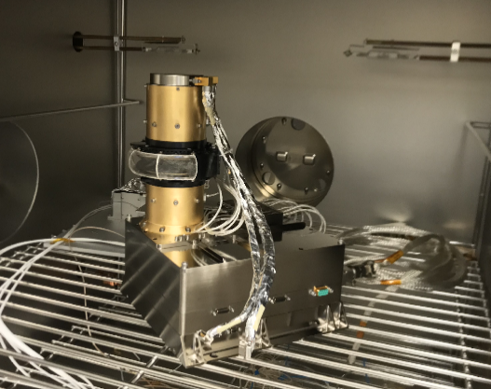
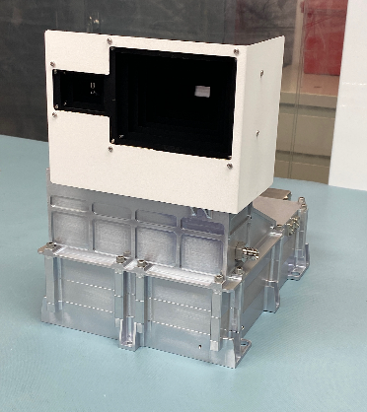
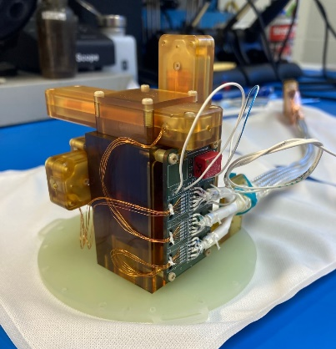
In Situ Measurements: Implementation
Solar Wind Plasma Sensor (SWiPS): Based on NASA’s IES for Rosetta and built by SwRI (PI: Rob Ebert), it will measure solar wind plasma moments.
SupraThermal Ion Sensor (STIS): Based on MAVEN/SEP and built by University of California, Berkeley (PI: Davin Larson), it will collect suprathermal ion and electron fluxes.
Magnetometer (MAG): A set of two fluxgate sensors, built by Univ. of New Hampshire and SwRI (PI: Roy Torbert), will measure the IMF.
Perf: 64 Hz
Perf: 2 sec
The SWFO in situ instruments have high heritage from research missions funded by NASA and other agencies
Instrument performance is expected to exceed requirements based on ground testing and, in one case (CCOR-1 coronagraph), on in-flight record.
The time resolution of the measurements will enable both operational (space-weather) and science usage.
These are expected to be reference measurements based on the location (L1 point), continuous operation/high availability, and low-latency (reqt: 5 min)
Notes:
The SWFO-L1 instruments have high heritage from earlier NASA and ESA missions. The requirements are shown in these tables.

Slide 4
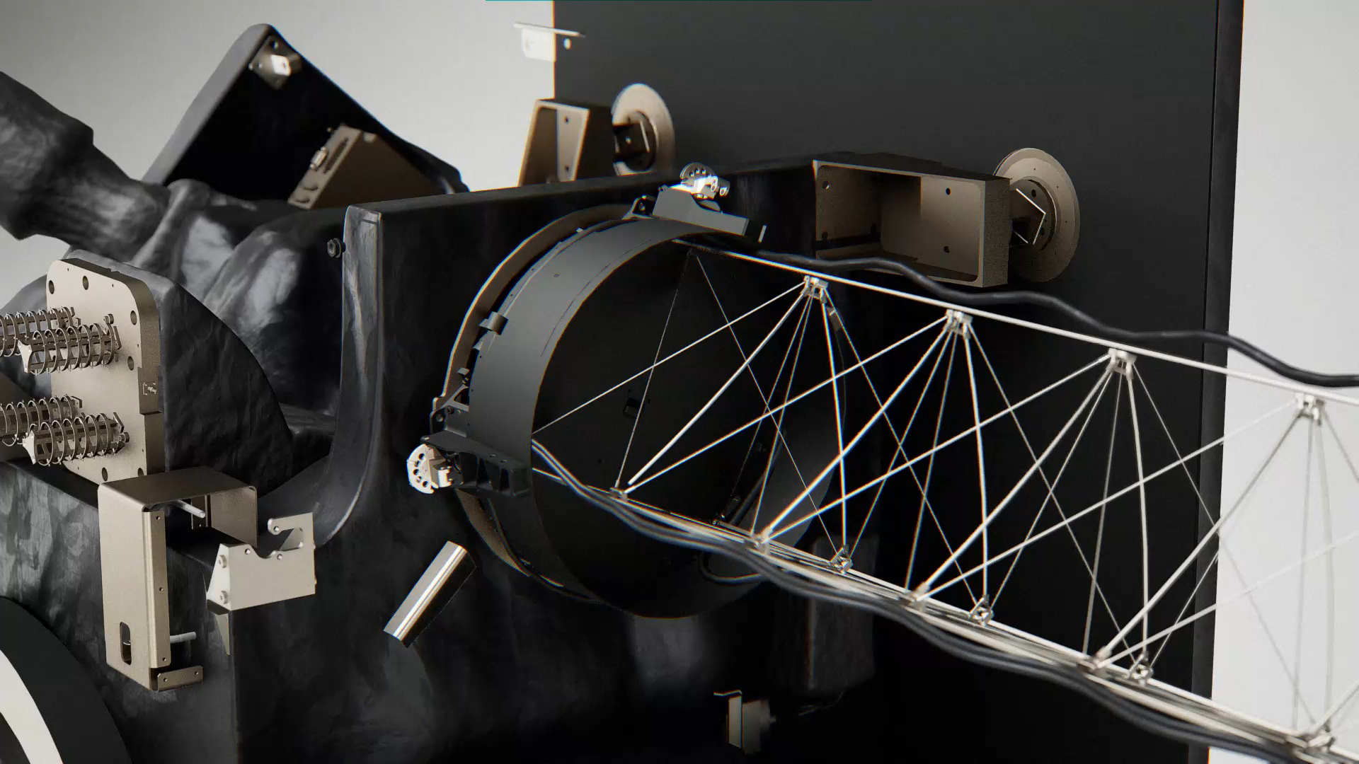

Status of Spacecraft and Instruments
Instruments on both ACE and DSCOVR are functional. Since their commissioning, ACE (1997) and DSCOVR (2016) have provided a largely uninterrupted record of the solar wind at L1. Data gaps are well documented by NASA and NOAA (NESDIS and SWPC).
SWFO-L1’s instruments SWiPS, STIS, and MAG:
  Integrated on the spacecraft last year and taken through environmental testing in summer/early fall of 2024.
  The observatory is ready and will be placed in temporary storage in February 2025. Launch is scheduled for September 2025.
SWFO-L1 animation
SWFO-L1 Observatory Youtube video (short version)
SWFO-L1 before environmental testing
(summer 2024)
Notes:
All instruments were integrated on the spacecraft in the winter and spring of 2024. They were thoroughly tested in the summer and early fall of 2024. The spacecraft has been ready for launch and later this month it will go into storage until its companions are fully ready for launch.
The pre-ship review is pending

Slide 5
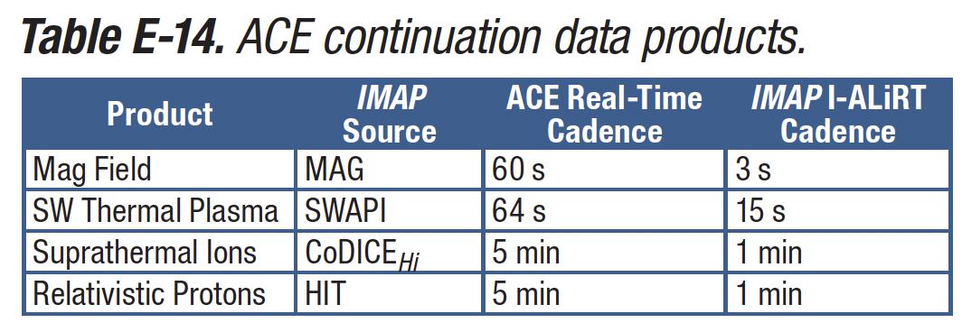
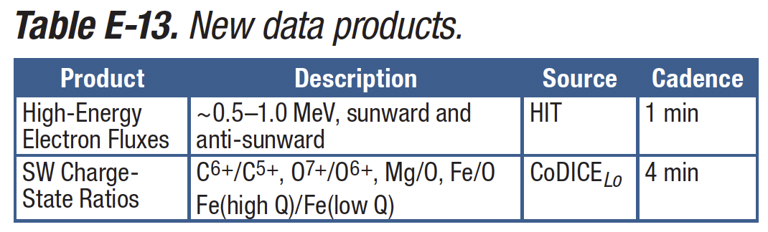
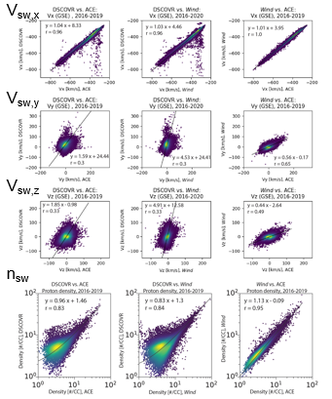
IMAP and other Missions at L1
The Interstellar Mapping and Acceleration Probe (IMAP) is a NASA mission designed to measure interstellar particles arriving at L1 using energetic neutral-atom (ENA) imaging and other techniques. IMAP will measure the solar wind at L1.
IMAP will provide high-priority solar wind, IMF, and particle data with minimal latency as the IMAP Active Link for Real Time (I-ALiRT).
SWPC will combine measurements from SWFO-L1, IMAP, and legacy missions as it does today with ACE and DSCOVR to provide a single best measurement for the solar wind/IMF at L1. Similar comparisons will be done between SWFO-L1, ACE, and IMAP for the particle flux.
The IMAP spacecraft is finalizing the integration stage. IMAP and SWFO-L1 are planned to launch together in September 2025.
Starting in 2026, six spacecraft (including WIND and Aditya-L1) are expected to simultaneously measure the solar wind at L1. There are good prospects for new discoveries in heliospheric physics and increased forecast accuracy.
  Intercalibration between corresponding plasma/IMF measurements from SWFO-L1, IMAP, and other missions is a major project, now in the planning stage. It will be useful to adapt or develop techniques such as those applied for ACE, DSCOVR, and WIND [e.g., Lotoaniu et al., 2022].
IMAP SpWx: ACE continuation
IMAP SpWx: New products
IMAP
Wind
DSCOVR
ACE
DSCOVR-ACE solar wind comparison (Loto’aniu et al., 2022)
Notes:
The Interstellar Mapping and Acceleration Probe is a NASA mission to measure interstellar populations arriving at L1 with techniques such as energetic neutral-atom (ENA) imaging. It will also measure the solar wind at L1 and provide these measurements as the IMAP Active Link for Real Time (I-ALiRT) beacon.
SWPC is preparing to obtain these measurements and use them as a second source of information for the solar wind/IMF. This will take place in the same way of how the measurements of ACE and DSCOVR are combined today.
The IMAP spacecraft is now in the integration stage with almost all its instruments integrated. The launch has been set to September 2025.
Currently there are plans for intercalibrating data from two or more spacecraft including ACE and DSCOVR while still operating; this will be similar to earlier studies, e.g., Loto’aniu et al., 2022.

Slide 6
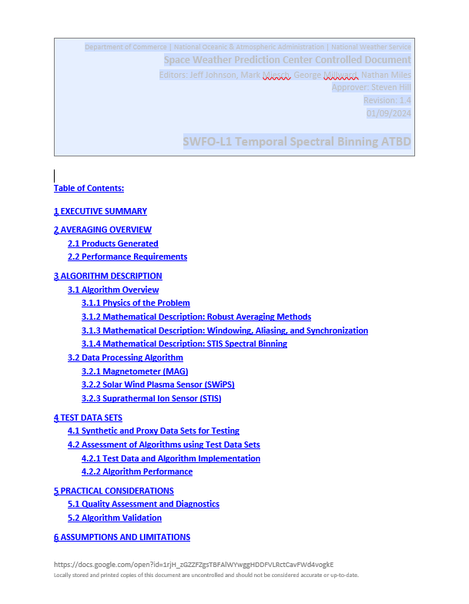
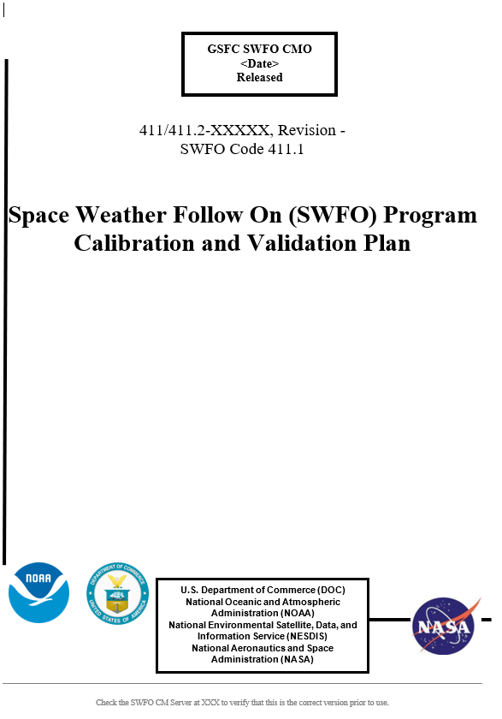
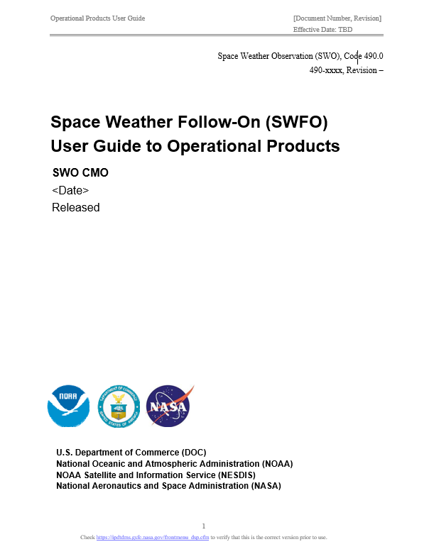
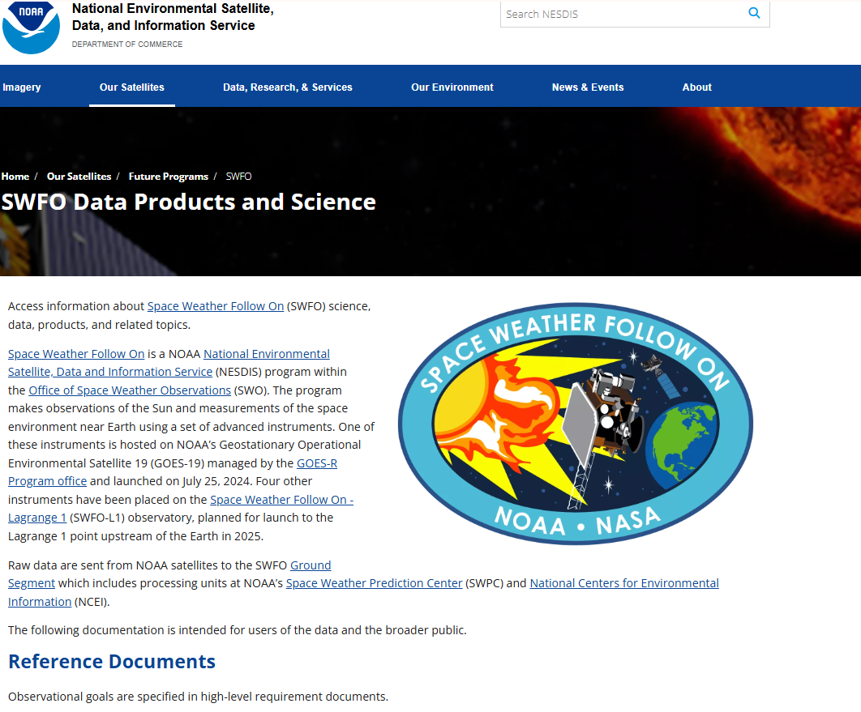
SWFO-L1 Public Documentation
SWPC: Algorithm Theoretical Basis Documents (ATBDs) for DSCOVR, SWFO-L1 ■
SWFO: Calibration and Validation Plan (CVP) ■
  Describes NRL- and NCEI-designed SWFO-L1 Post-Launch Commissioning (PLC) and Post-Launch Product Testing (PLPT)
NCEI: Metadata list ■
UCB, NCEI, SWO: presentations in 2024 ESWW (1), AGU (5) ■
SWFO: Product User Guides (PUGs) ■
SWFO: Data products and science webpage ■
NRL, SWPC, NCEI: instrument and processing papers to be submitted to Space Science Reviews ■
Note: many of the above documents are subject to revision, including those that are currently available for distribution (ATBD, CVP, etc.).
ATBD (Time Series), CVP, PUG-Ops
Webpage
Notes:
The ACE and DSCOVR spacecraft have been well documented. They have helped develop heliospheric and geospace models, and have led to large numbers of papers.
For SWFO-L1, the documentation has recently started. SWPC has written an algorithm theoretical basis document. Calibration and validation functions are important and the CVP describes the pre- and post-launch stages (PLCs, PLPTs [no PLT for SWFO-L1]).
There are intercalibration papers such as [Lotoaniu et al., 2022].

Slide 7
Summary
In situ measurements from L1 include several KPPs (and in the future: HAPs) for NOAA missions based on SWPC priorities.
SWFO-L1 has completed integration of its instruments and testing, and is about to be placed in storage in February 2025. It is scheduled to launch as a rideshare with NASA’s IMAP in fall 2025.
  At that point, six new and legacy spacecraft will be in orbit around L1; it is expected that the plasma/IMF measurements will lead to new insights in solar wind physics and improved forecasts.
Documentation on SWFO-L1 and its instruments is available and additional documents are in preparation.
  Descriptions of the Cal/Val process are available in the Calibration and Validation Plan.
SWFO-L1 Observatory Youtube video (short version)
Notes:
In closing, the data from SWFO-L1 and the operational data stream from IMAP, the I-ALiRT, will continue to provide the solar wind/IMF input needed by operational and research models.
The operational data from SWFO-L1 and IMAP will be available at SWPC along with those of ACE and DSCOVR as long as they are operating.
The retrospective data from SWFO-L1 and DSCOVR are available from NOAA while those of ACE and IMAP are available from NASA.

Slide 8
Backup

