Slide 1
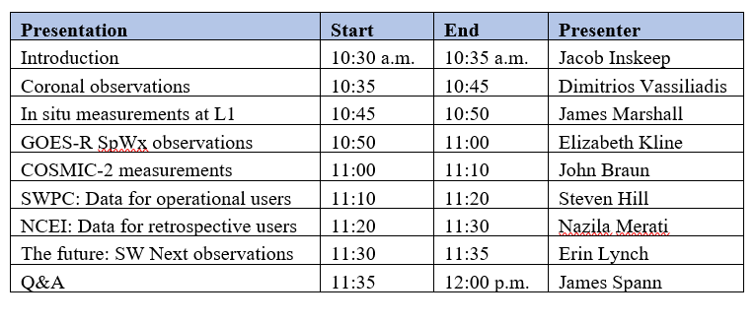
User Readiness for Space Weather Data from NOAA POR 2025 Missions
Agenda:
The meeting will be recorded.

Slide 2
1. Introduction
Jacob Inskeep, SWFO PGD Systems Engineer
Notes:
Welcome everyone. My name is ___, and I am the ___ (title: SWFO PGD systems engineer).
This is a session on user readiness for space weather data from SWFO and other NOAA missions organized by the SWFO program.
In this brief introduction, I will cover some preliminaries.
The objective of this session is to familiarize users with space weather datasets from NOAA: what they are, where to find them, what levels, formats, metadata, and possible limitations they may have.
Space Weather Follow On is a program within the Space Weather Observations (SWO) office at NOAA/NESDIS. We have some new observations starting in 2024 and expect to have more later this year so we would like to present both those and earlier data and provide information to the users about legacy and new features.
Next, this meeting is being recorded. By attending the meeting, you consent that any verbal participation will be recorded. The recordings will be made available at a SWO website which is expected to go live this week. We should be able to upload the recordings within two weeks from the meeting.
The PDFs of the talks will be kept on the same website.
We thank AMS for hosting this event. The event contains some updates from the previous such session held last April at the Space Weather Workshop, in Boulder, CO.

Slide 3
NOAA SpWx Data: Provision to Users
Space Wx Region | Observation | NOAA (or other Agency) Mission (#) | Sensor | Data Start | Operational Data Access | Retrospective Data Access
Sun (corona) | EUV imagery, EUV and X-ray irradiance | GOES-16 to -19 (4) | SUVI, EUVS, XRS | 2016 | SWPC: X-ray irradiance | NCEI
 |  | NASA/SOHO | LASCO | 1997 | Display only | NA
 |  | GOES-19 | CCOR-1 | 2025 | SWPC | NCEI
 |  | SWFO-L1 | CCOR-2 | 2026
Heliosphere (solar wind at L1; particles at L1 or at GEO) | L1: Plasma, B-field | DSCOVR | FC, MAG | 2016
 | L1: Plasma, B-field; Suprathermal particle flux | SWFO-L1 | SWiPS, STIS, MAG | 2026
 | L1: Plasma, B-field; Suprathermal+SEP flux | NASA/ACE | SWEPAM, EPAM, MAG | 1997 |  | NA
 | GEO: SEP flux | GOES-16 to -19 (4) | SEISS (SGPS, EHIS) | 2016 | SWPC: Selected channels | NCEI
Magnetosphere | GEO: Particle flux, B-field |  | SEISS (MPS-Lo, -Hi), MAG | 2016
 |  |  |  |  | SWPC: 2MeV flux, B-field
Ionosphere | Electron density profile, plasma drift velocity | COSMIC-2 (7) | TGRS IVM | 2021 | UCAR | UCAR
Notes:
This table summarizes most of the frequently used space weather datasets used by NOAA and provided to the public.
The table covers all space weather regions. You will notice that some of the datasets are obtained by NASA or a different agency and used operationally by NOAA. In those cases, NOAA displays the imagery or time series graphs, but does not make the data available since they are made available by NASA or a different agency.
A slightly more detailed version of this table is available in the invite.

Slide 4
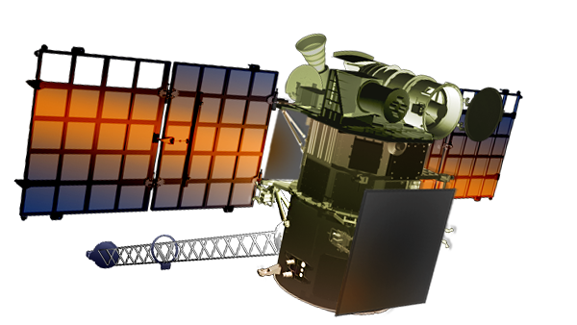
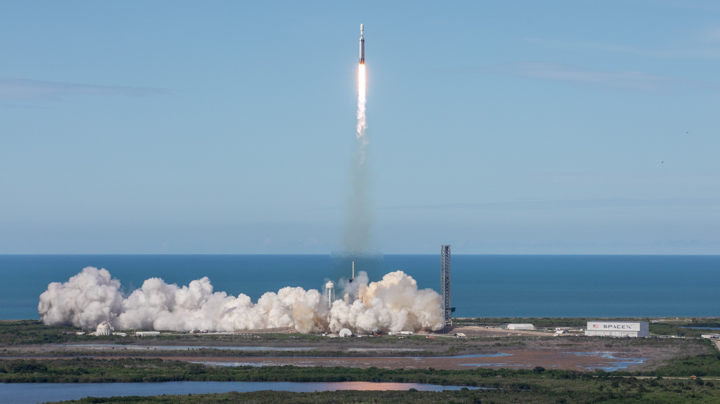
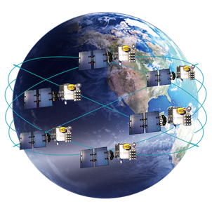
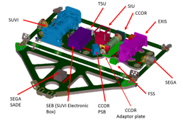
NOAA’s Program of Record 2025
The Program of Record 2025 for NOAA’s space weather observations contains satellite systems, instruments, and interagency data exchanges:
DSCOVR at Lagrange 1 (L1)
Operationally used data from NASA’s LASCO and ACE at L1
SWFO-L1 at L1 (planned for 2025)
SpWx data from GOES-16 to GOES-19 (4 satellites) at GEO
GOES-19 hosts SWFO’s CCOR-1 instrument
Data from NASA’s GOLD at GEO
COSMIC-2 (7 satellites) at LEO
POES at LEO
Note: NOAA will also be using near-real-time data from NASA’s IMAP and PUNCH missions with both planned to launch in 2025. However there are no plans for NOAA to archive or distribute these data to retrospective users.
GOLD&&
DSCOVR (2015)
GOES-19 launch (2024)
COSMIC-2 (2019)
GOES-19 Sun-Pointing Platform hosting CCOR-1
SWFO-L1 (2025)
Notes:
The Program of Record 2025 for NOAA space weather contains the following missions:
(read from the list)
They will be covered in different talks in this session

Slide 5
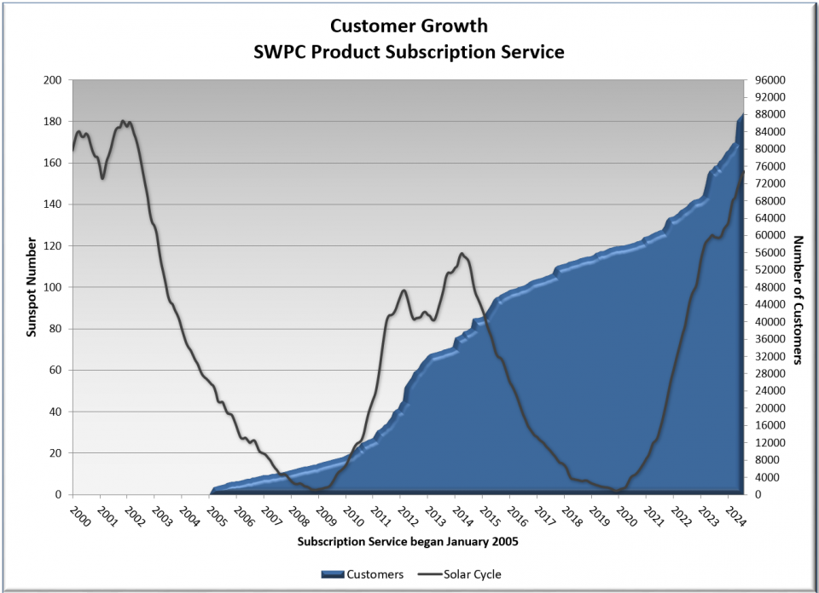
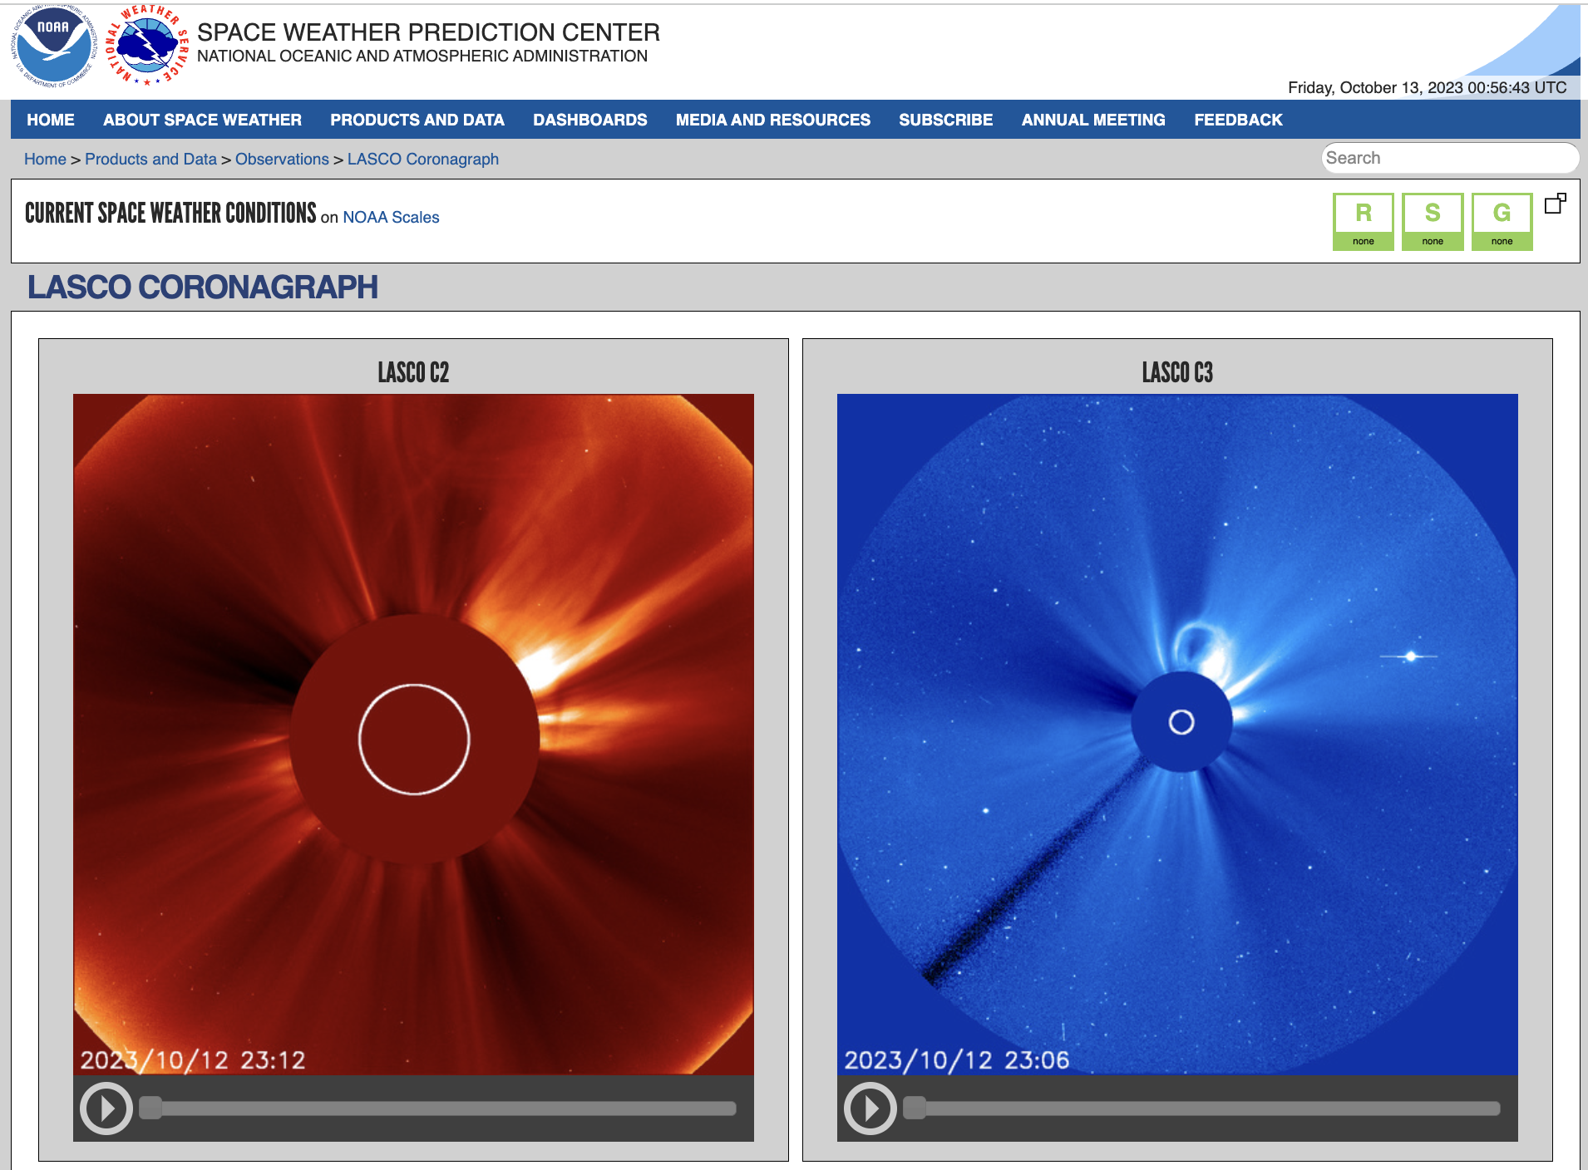
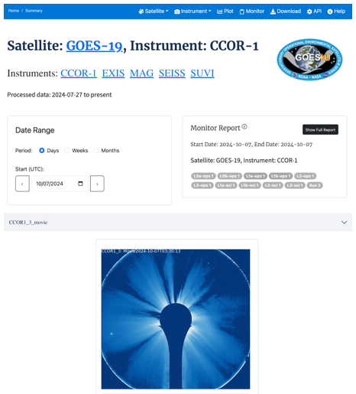
Operational and Retrospective Users
NOAA’s Space Weather Prediction Center (NCEI) makes available data in near-real-time to operational users.
Operational users include SWPC’s own Forecast Center, international forecast centers, power grid operators, satellite managers, federal and state emergency management offices, GNSS operators, etc.
NOAA’s National Centers for Environmental Information (NCEI) office archives space weather data and makes historical data available to retrospective users. In addition, NCEI leads several stewardship services.
Retrospective users include academia and other educational institutions, industry, and others. They use the data off-line for model development, educational projects, etc.
Identifying and meeting needs for the two user categories is central to the development of observations at NOAA/NESDIS.
SWPC subscriptions reach 80K in 20 years.
NCEI’s SPOT: an upgraded interface for product distribution
Notes:
While the objective is to address the needs of all users of space weather data, we distinguish between operational users who need the data in near-real-time (with minimum latency such as of the order of minutes) and retrospective users who use the data off-line for model development, educational projects, etc.
SWPC and NCEI will present updates on their approaches for distributing data to their users.

Slide 6
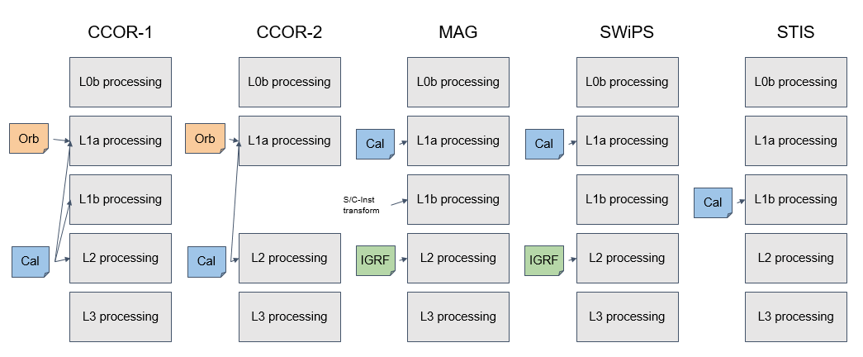
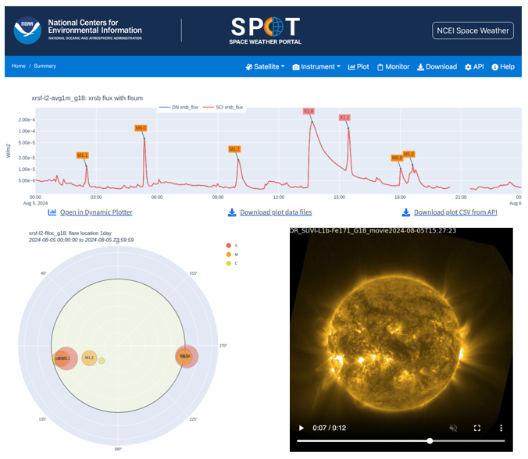
Key Functions
SWPC and NCEI implement Product Generation, which is the development of products from raw or low-level data.
The products are generated in near-real-time or off-line, respectively.
SWPC and NCEI also implement Product Distribution, the process of making products available for access.
NCEI has recently introduced its Space Weather Portal (SPOT) with upgraded search and visualization functions.
Finally, NCEI implements Calibration and Validation (Cal/Val) for all SpWx data which is a critical function for increasing product quality.
SWPC: product pipelines
NCEI:
SPOT demo
Notes:
We will also talk about the main functions: product distribution (or data access) takes place at different servers for operational and retrospective users.
SWPC provides data to operational users as soon as possible (within minutes). NCEI archives the data and provides them through a modern interface called SPOT at any time for the duration of the mission and beyond.
Calibration and validation of the data are important for product quality. We will not discuss this in length, but will indicate at what stages it is done and how one can obtain additional information.

Slide 7
Summary
Today’s meeting provides an update from last year’s session.
This talk has introduced the Program of Record 2025 and the types of users of NOAA space weather data.
Notes:
(read text)
Thank you for your attention. We will now continue with a presentation on coronal observations.

Slide 8
Backup

