Slide 1
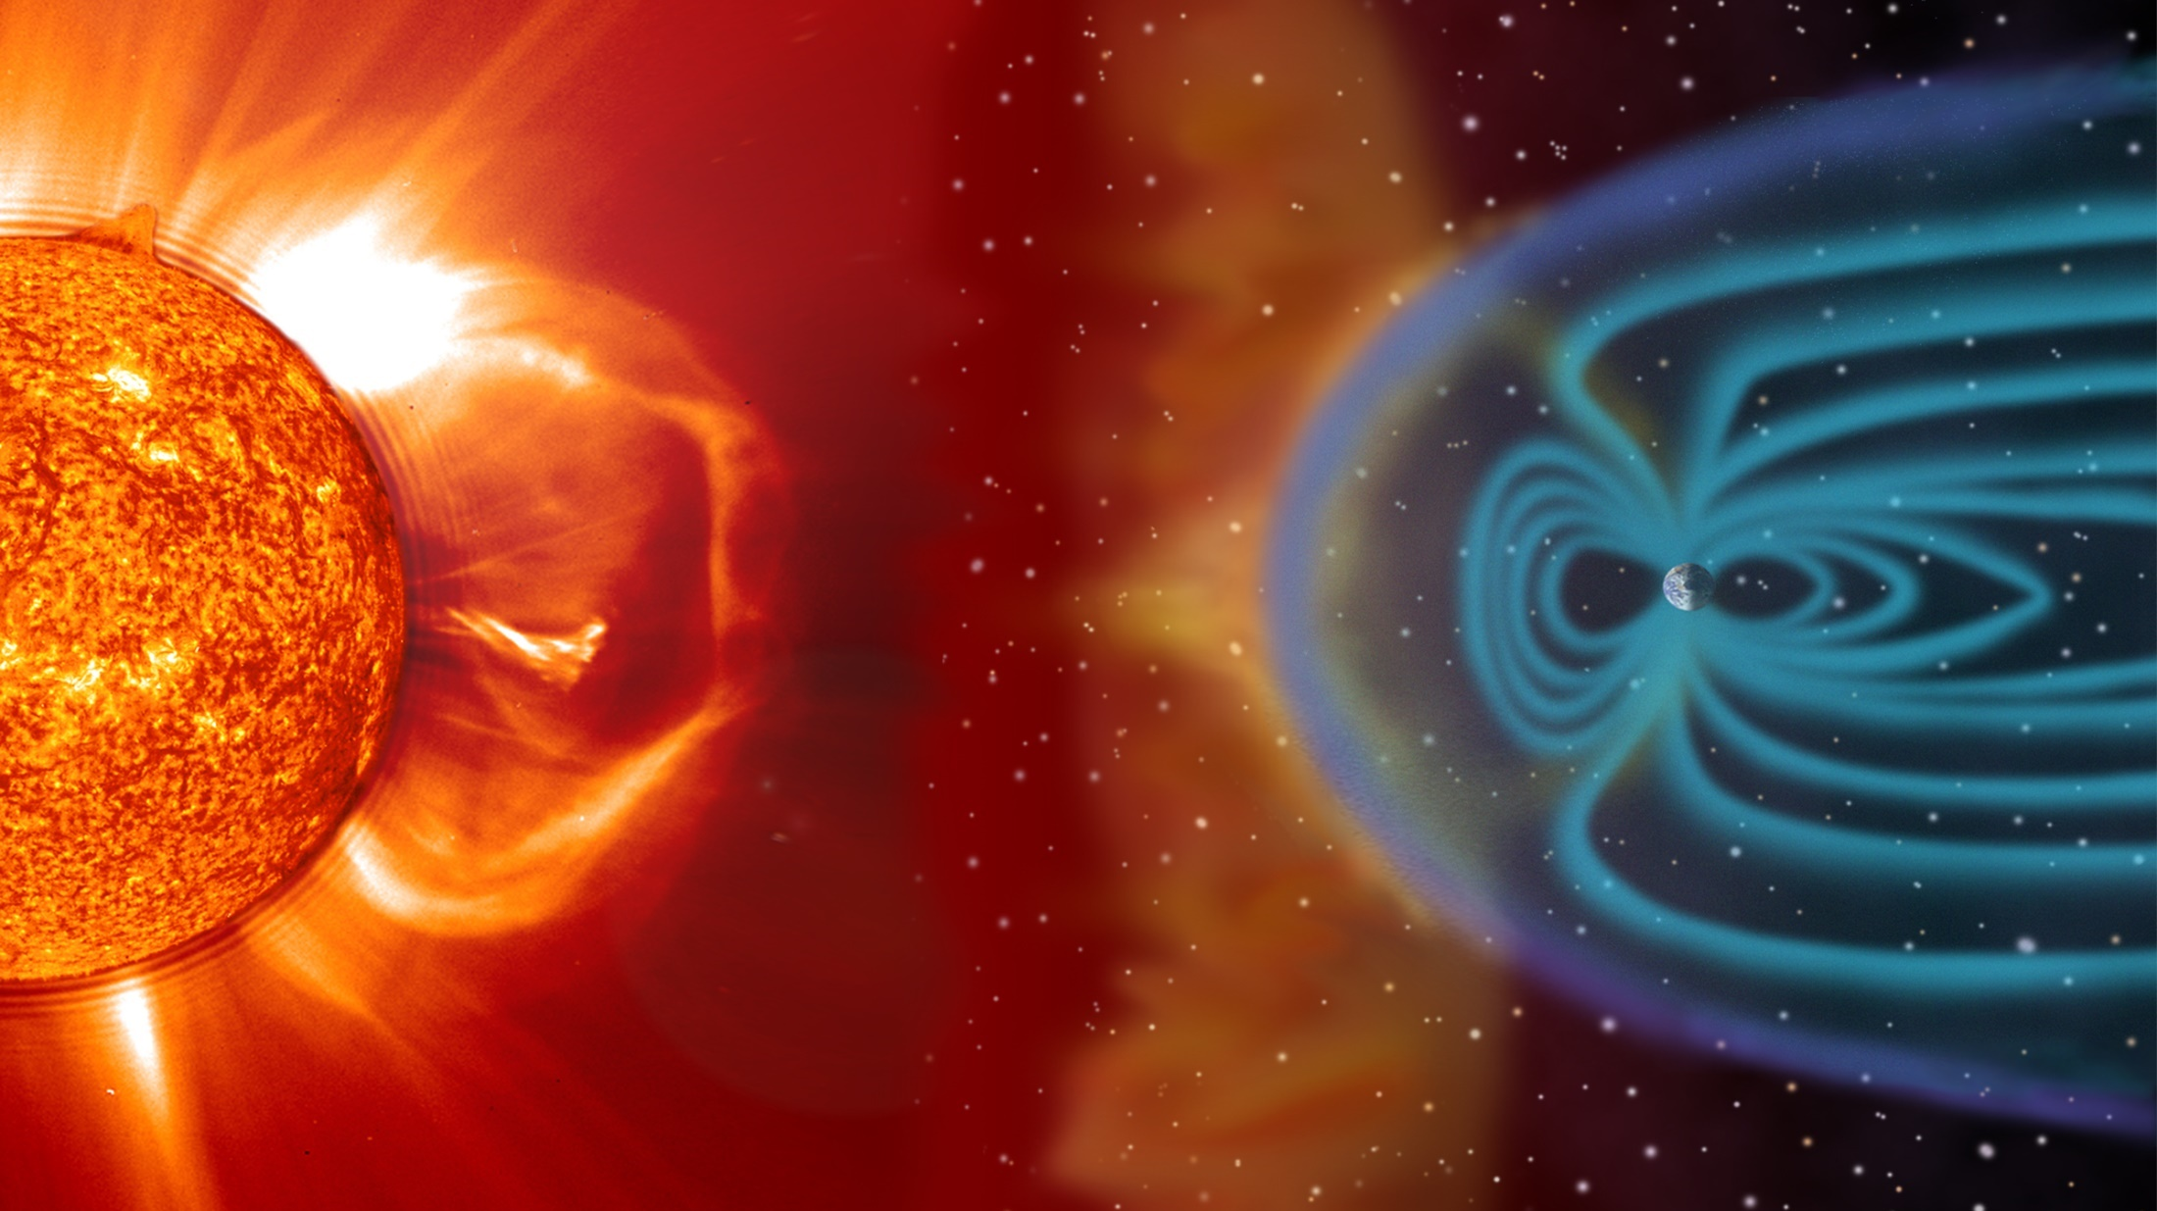
Slide Title
4c. Solar Wind Plasma Sensor (SWiPS)
Ground Processing Algorithm (GPA)
Heather Elliott, Brad Trantham,
Rebecca Perryman, Nicole Standiford, and Robert Ebert
August 30, 2021

Slide 2
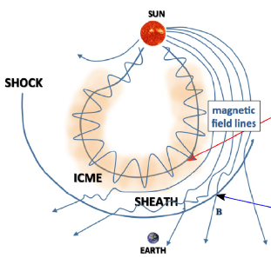
SWiPS Science
The SWiPS will measure solar wind ions, the super-sonic flow of hot plasma from the Sun, at 1 AU.
The measurements are used to characterize Space Weather causing events such as:
Coronal mass ejections (CMEs).
Interplanetary (IP) shocks.
Corotating interaction regions (CIRs).
High-speed flows associated with coronal holes.
SWiPS provides early warning of changes which affect the geomagnetic environment.
CMEs and IP Shocks
Kilpua et al. 2017
shock
Deforest, de Koning, & Elliott, 2017

Slide 3
SWFO-L1 Performance Requirements
Measurement | SWFO-L1 Performance Requirement
Cadence | 1 minute
H+ Velocity Range | 200-2500 km s⁻¹
H+ Velocity Accuracy | +/- 10%
H+ Density Range | 0.1 -150 cm⁻³
H+ Density Accuracy | +/- 10%
H+ Temperature Range | 40,000 -2,000,000 K (3.45 to 172.3 eV)
H+ Temperature Accuracy | +/- 10%
SW H+ & He++ Dynamic Pressure 1 - 100 nPa | Consistent with ranges for n and V.
R: 4.13 Product Generation, 4.15 Calibration and Validation; C: SDD

Slide 4
SWiPS Data Products
Level | Data Product Description
0 | Individual packets; e.g. rates at a energy- angle steps
0b | Sets of packets containing complete energy-angle sweeps
1a | Decommutated housekeeping and science packets at full time resolution Science data includes count rates at 128 energy bins, 14 azimuth bins, & 9 elevation bins Quality: Poisson errors, checksum, red, yellow, green limits (currents, temperatures count rate saturation limits. etc.) Ancillary Data Used: S/C Attitude and ephemeris
1b | Phase Space Distribution function as a function of energy, and azimuth and elevation in degrees.
2 | Protons: Vx, Vy, Vz (GSE coords and GSM coords) n (density) T (Temperature) Alphas: n (density, speed) | Alphas: n (density, speed) Total: P (dynamic pressure) Other: Status, quality flags, error bars, # of samples Ancillary Data Used: S/C Attitude and ephemeris
R: 4.13 Product Generation, 4.15 Calibration and Validation; C: SDD

Slide 5
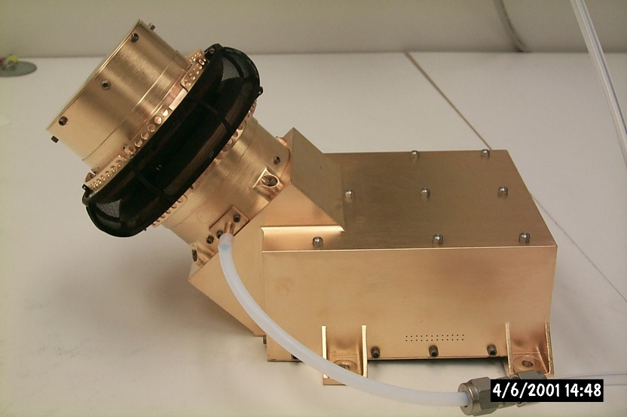
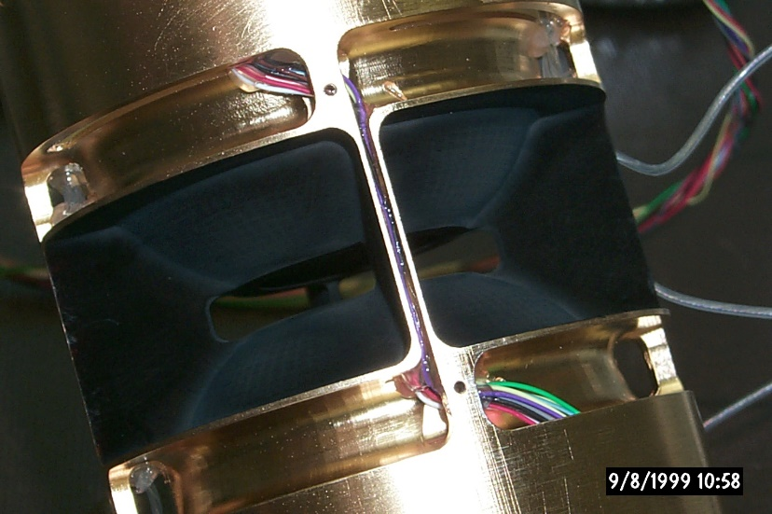
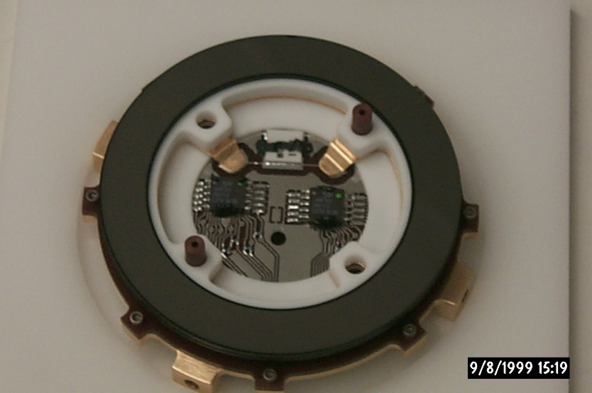
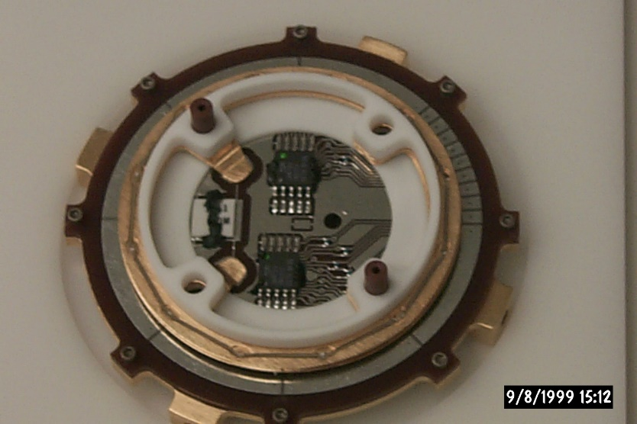
SWiPS Design Concept (Rosetta/IES Heritage)
Heritage Instrument
Angle
Deflector
Heritage ESA
Microchannel
Plates (MCPs)
Ions
Ions
Rosetta/Ion and Electron
sensor (IES)
Ions
Electrostatic
Analyzers (ESAs)
Toroidal
Entrance Grid
Heritage MCPs/Detector
Heritage Anode
Two sensor heads, both designed to measure ions.
ESA voltage range of 16 – 3200 V is covered in 128 steps.
Deflectors scan out-of-ecliptic FOV using electrostatic deflection.
MCPs are Z-stacked (3 plates).
Notes:
Rob Presents?

Slide 6
Instrument Properties
Parameter | Value
Energy Range | 0.17 – 33 keV/q
Energy Resolution (∆E/E) | 0.08 eV/eV
Analyzer Constant (k) | 10.15 eV/V
Geometric Factor (per anode) | 1.5x10⁻⁵ cm² sr eV/eV
Field-of-view | 90∘ (azimuth) 45∘ (elevation)
Azimuth Resolution | 5° (< |±25°|) 10° (> |±25°|)
Elevation Resolution (intrinsic) | 1.8 – 3.5°
R: 4.13 Product Generation, 4.15 Calibration and Validation; C: SDD

