Slide 1
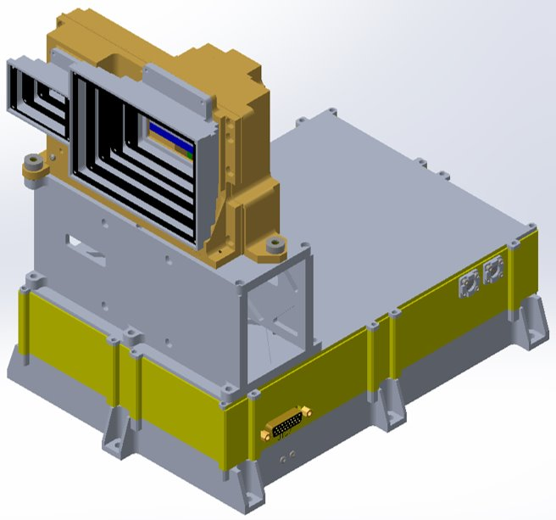
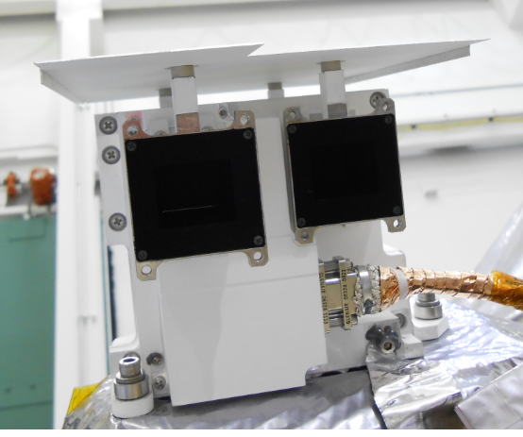
4d. STIS GPA Structure and Development
SWFO-L1/STIS
Heritage: MAVEN/SEP
Davin Larson
SWFO PGD PDR
August 30, 2021
Virtual Meeting Room

Slide 2
UCB Point of Contact
PI: Davin Larson
Email: davin@berkeley.edu
Cell Phone: 925-708-3426
Work: 510-642-7558
Science Team:
Ali Rahmati rahmati@berkeley.edu
Phyllis Whittlesey
Patrick Dunn
Christina Lee
Janet Luhmann
Project Manager : Michael Ludlam
Email: michaelludlam@berkeley.edu
Phone: 415-806-3277
Systems Engineer : Miles Robinson
Email: miles.robinson@berkeley.edu
Phone: 574-304-9571

Slide 3
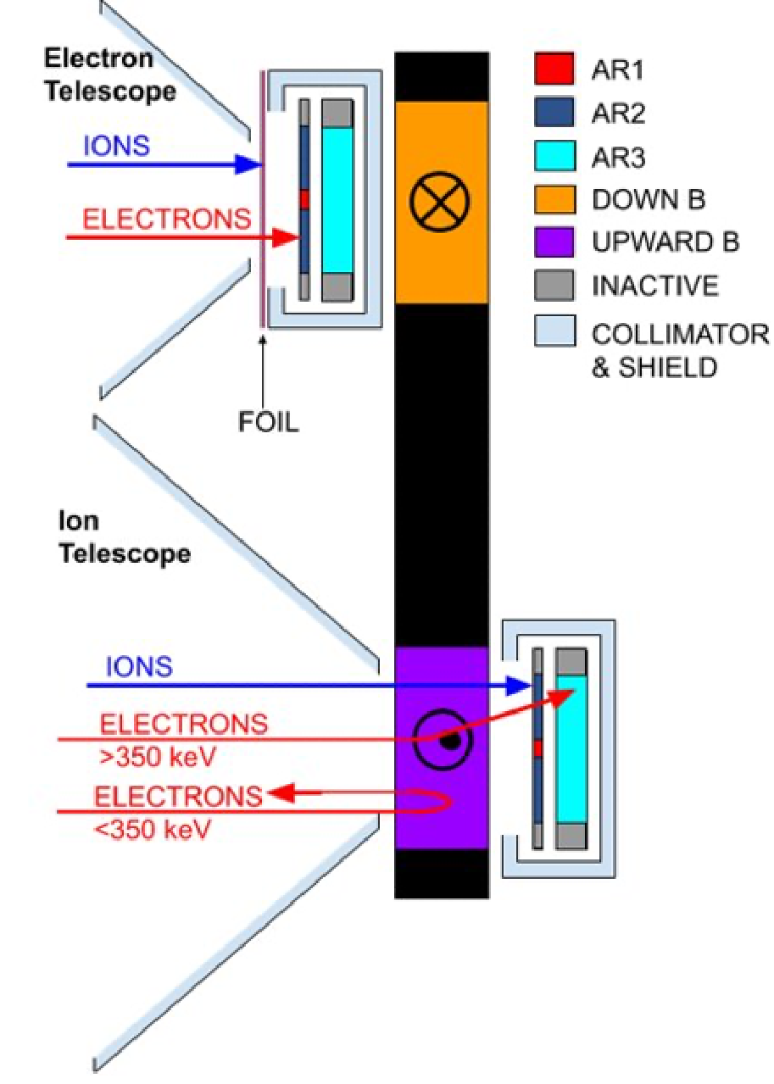
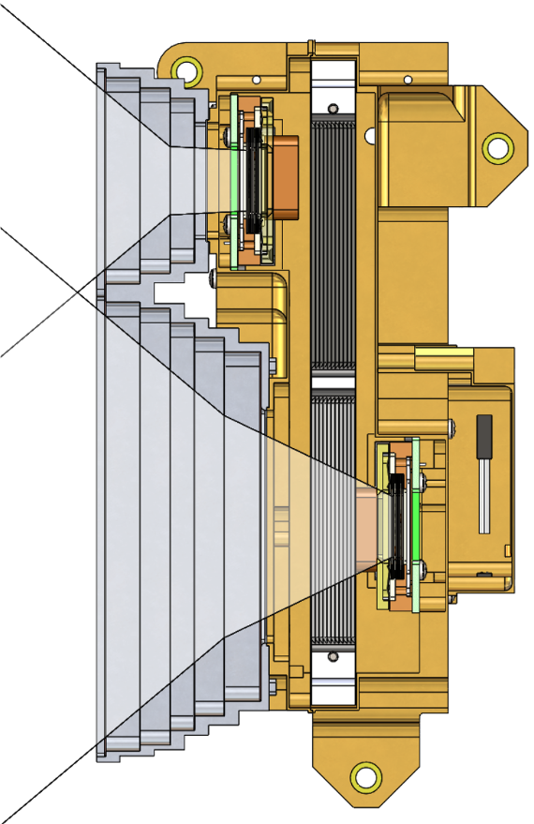
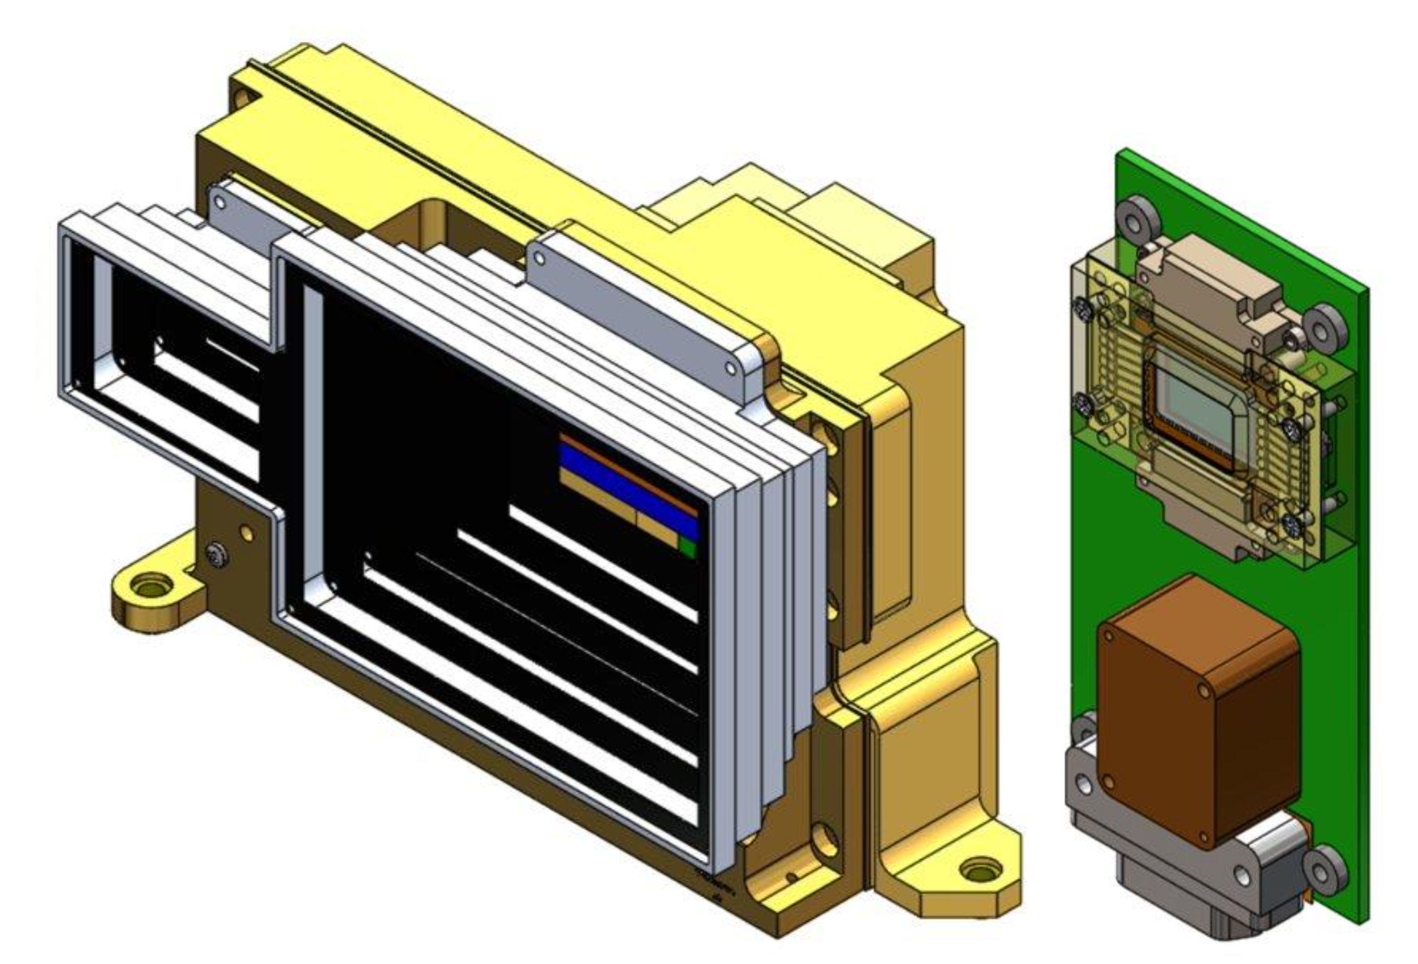
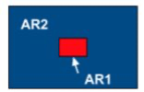
Instrument Overview
Main heritage: Solar Energetic Particle (SEP) instrument onboard the Mars Atmosphere and Volatile Evolution (MAVEN) spacecraft
Compared to the MAVEN/SEP detector, the STIS field of view is significantly wider (80°x60° versus 42°x31°), but only has one look direction for both telescopes
STIS consists of 2 telescopes (ion telescope & electron telescope), each consisting of a double stack of solid-state (SST) detectors and measuring: • Ions (25keV–6MeV) • Electrons (25keV–250keV)

Slide 4
Performance Requirements Summary
SWFO LEVEL 1 REQUIREMENT | STIS DESIGN
4.1.1 Definition of Minimum and Maximum Flux limits STSPEC-24: Minimum Flux: 2.48e2 * E(keV)^{-1.6} STSPEC-25: Maximum Flux: 1.01e7 * E(keV)^{-1.6} (note: this is not really a requirement, it serves as a definition) | The heritage MAVEN/SEP instrument performs within these limits. The STIS geometric factor is chosen to meet the Maximum flux limit without exceeding the count rate that the heritage instrument can handle without significant deadtime correction. (Consistent with count rate of 30000 cnts/sec)
4.1.2 Flux Measurement Range STSPEC-27: The STIS shall provide ion differential flux measurements in the range of 50KeV - 2,000 KeV. Discrimination of flux constituents or species is not required STSPEC-28: The STIS shall determine the differential ion fluxes in sufficient evenly spaced logarithmic energy bands to meet the accuracy requirement defined in section 4.1.3 STSPEC-928: The STIS instrument shall provide >3 bands in a logarithmic bin per energy decade. | Compliance. The heritage MAVEN/SEP instrument measures energies from ~25 keV to 6 MeV and the STIS design retains this capability. This exceeds the measurement requirements. (Test results show electronic threshold at ~10 keV.) Both the Heritage and STIS designs include programmable energy bins (1.5 keV resolution) that meet these requirements.
4.1.3 Accuracy: STSPEC-30: The STIS instrument shall be capable of measuring differential fluxes at the minimum flux with ±100% accuracy varying, as the Poisson statistics improve, down to ±20% at the maximum flux accounting for all error sources. Error sources include but are not limited to noise, out-of-band response, energy band edge uncertainty, poisson statistics, and facility calibration error. | Compliance. The heritage and STIS sensors both meet this requirement. Min flux limited by GCR flux and poisson statistics Max flux limited by knowledge of GF. (modeled by GEANT4) Large dynamic range enabled using 2 pixels
R: 4.13, 4.15; C: SDD

Slide 5
Performance Requirements Summary
SWFO LEVEL 1 REQUIREMENT | STIS DESIGN
4.1.4 Field of View (FOV) STSPEC-32: The STIS FOV shall be at least 80 degrees in the ecliptic by 60 degrees centered 50 degrees in the ecliptic off of the sun-earth line in the “ahead” direction (the ahead direction is the direction the earth travels in the ecliptic). In the Spacecraft Reference Frame (SRF) coordinates (see section 5.4), the unit vector for the centroid of the FOV of the instrument shall be (0.643, 0, 0.766). | Compliance. The heritage sensor did not meet this requirement. The proposed STIS design has replaced the collimators with a larger FOV to meet this requirement. The pointing requirement is leveled by the S/C. UCB will work with S/C to insure pointing requirement is met.
4.1.5 Refresh Rate and Latency STSPEC-35: The SWFO-L1 mission will make STIS Solar Wind data available to SWPC forecasters within 5 minutes of the completion of each data acquisition and the STIS instrument shall provide, as a minimum, one data collection in each 5 minute window. STSPEC-36: The processing of a completed on-orbit data collection by the STIS instrument and the transmission to the spacecraft shall contribute ≤ 2 seconds to the overall latency of the solar wind data product. STSPEC-37: The processing of a completed on-orbit data collection by the STIS instrument and the transmission to the spacecraft shall contribute ≤ 2 seconds to the overall latency of the solar wind data product. | Compliance. MAVEN/SEP has intrinsic (minimum) time resolution of 1 second. The STIS instrument design will be programmable from 1 to 512 seconds. Latency is < 0.1 second. Ground processing latency is estimated at <1 second.
4.1.6 Response Stability - STSPEC-39: The STIS instrument shall provide monotonically increasing fluxes up to three times the maximum flux for a given energy range. | Compliance: The heritage design is non-paralyzable. verified by testing - Electronics shown to handle ~100 kHz. The proposed STIS design will be similar.
R: 4.13 Product Generation, 4.15 Calibration and Validation; C: SDD

Slide 6
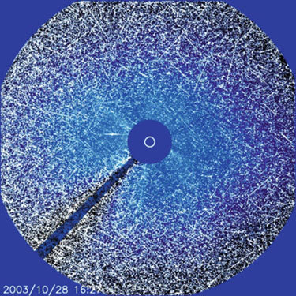
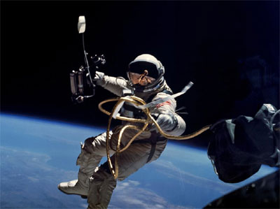
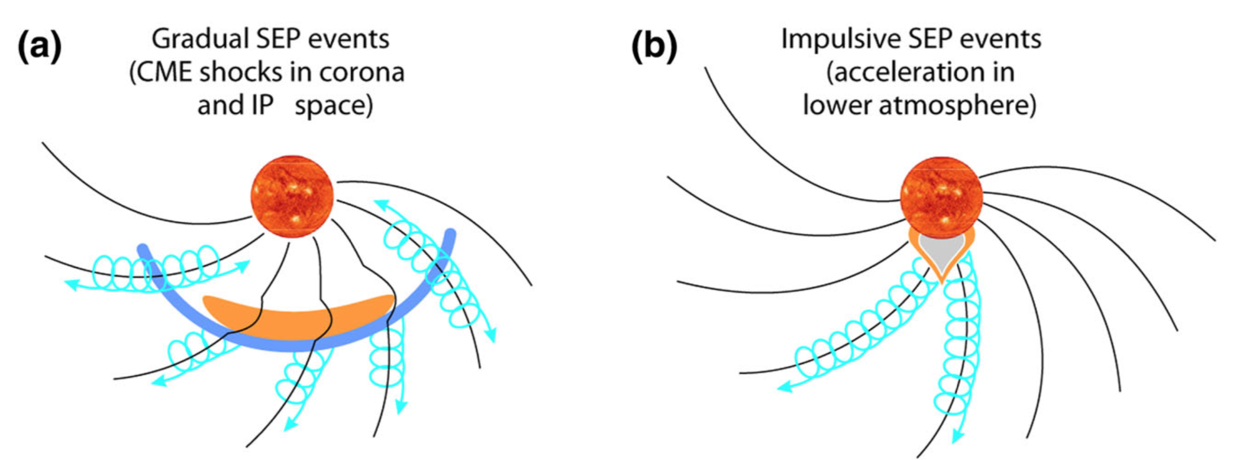
Science Overview: SEPs
Due to their high energies released over short time scales, SEPs are considered a significant space weather hazard (impact on space technology, avionics, and living organisms).
• Solar energetic particles (SEPs) are enhancements of particle fluxes at high energies
• Composed of mostly energetic protons and ions (mainly ionized H, He), with energies of 20 keV – few GeVs (~GeV protons → ground-level enhancements or GLEs)
• Some energetic electrons, alpha-particles, and highly ionized heavier ions up to Fe, with energies up to a few tens of MeVs
• Acceleration sites: solar flares (“impulsive” events), CME-driven shocks (“gradual” events)
High-energy protons (>30 MeV) are a health risk for astronauts
→ proton fluxes are taken into account when planning EVAs.
Image: NASA
“Snowstorm” effect on the SOHO/LASCO C3 coronagraph during the Halloween storm. Image: ESA/NASA
Figure: Desai & Giacalone (2016)

Slide 7
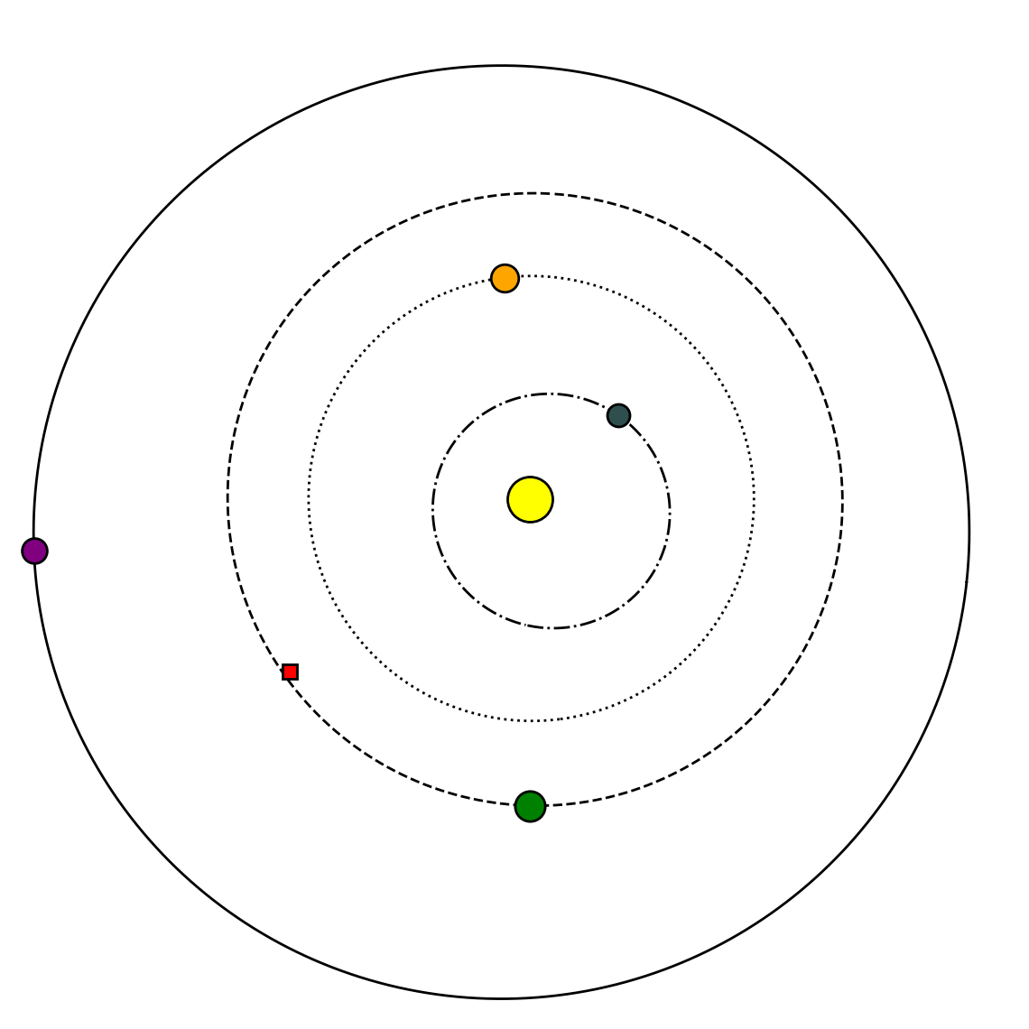
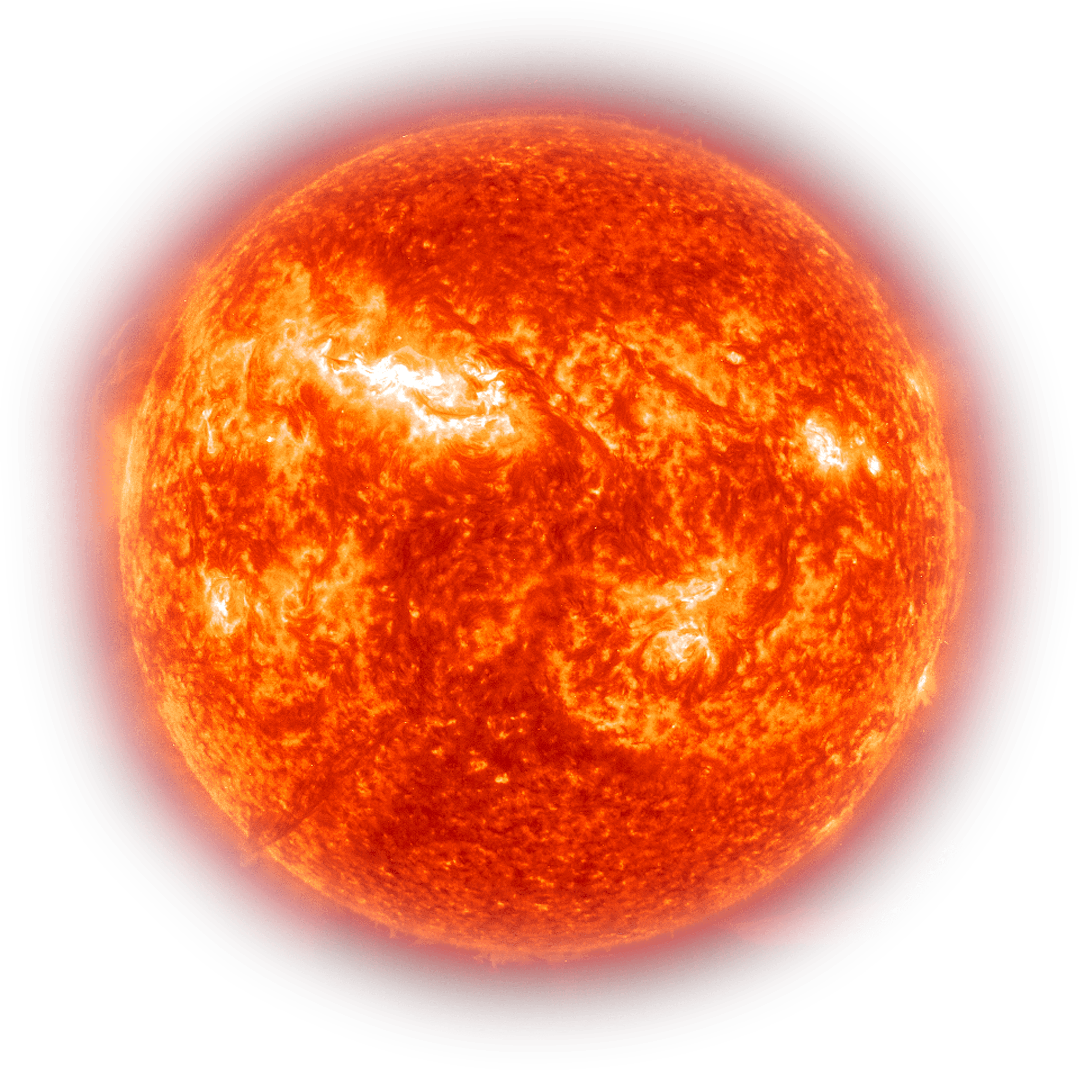
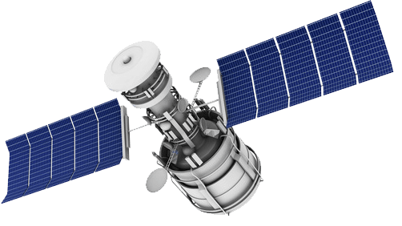
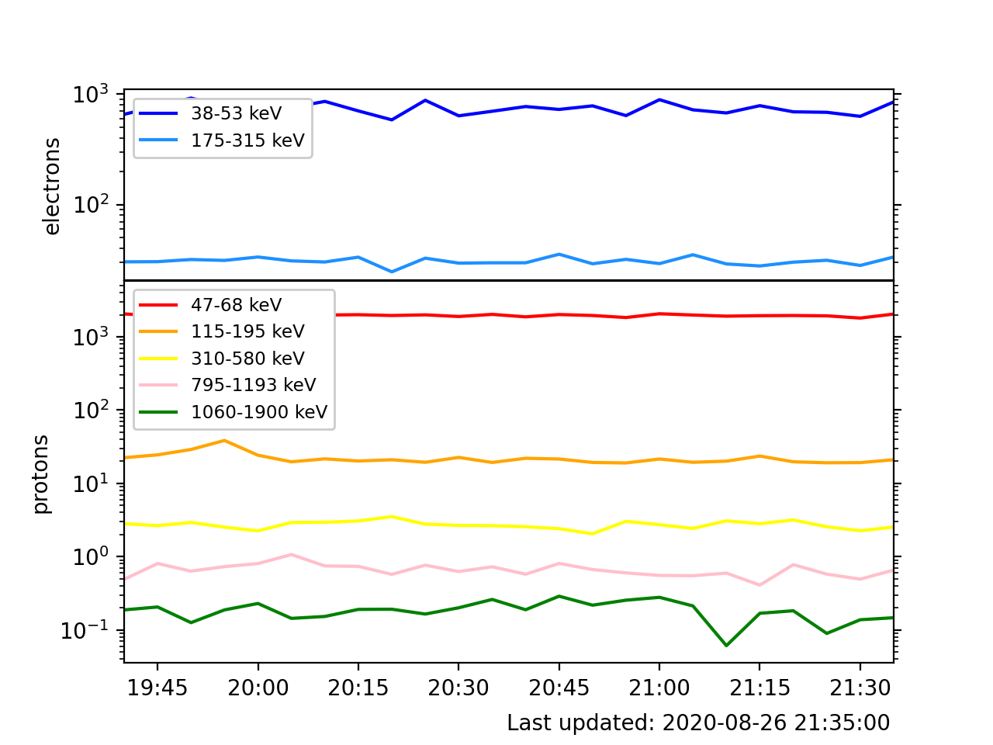
Science Overview: SWFO-L1
1.5 x 10⁶ km
148.5 x 10⁶ km
Mars
Data: ACE/EPAM
STIS is onboard SWFO-L1, orbiting Earth’s Lagrange L1 point, optimal location for monitoring the solar wind and Earth-directed radiation
STEREO-A
Earth
Current space weather assets: • Spacecraft near Earth (ACE, DSCOVR, GOES…) • STEREO-A
MAVEN (including the SEP instrument that is the main heritage for STIS) is in orbit around Mars
STIS monitors the flux of energetic protons and electrons as a function of energy in real time

Slide 8
Energy Channels
ACE/EPAM
SWFO-L1/STIS versus ACE/EPAM (mid channel energy)
SWFO-L1/STIS*
ions (keV) | electrons (keV)
ions (keV) | electrons (keV)
56 | 53
88 | 79
150 | 133
250 | 225
424
789
1419
3020
20.8 | 203.0 | 21.0 | 206.9
22.3 | 261.8 | 22.5
23.7 | 339.8 | 23.9
25.8 | 442.6 | 26.1
28.6 | 577.3 | 29.0
32.2 | 755.2 | 32.6
37.1 | 989.8 | 37.7
43.6 | 1298.9 | 44.2
52.0 | 1706.5 | 52.9
63.4 | 2243.0 | 64.4
78.2 | 2949.0 | 79.6
98.1 | 3879.0 | 99.9
124.3 | 5111.7 | 126.7
158.3 | 6687.2 | 161.4
Note 1: The higher “electron” channels (blue shade) in both STIS and EPAM are able to detect mostly ions Note 2: STIS L3 data will have their energy channels re-binned to be consistent with EPAM data
*Energy Bins are programmable - MAVEN/SEP bins are shown
R: 4.13 Product Generation, 4.15 Calibration and Validation; C: SDD

Slide 9
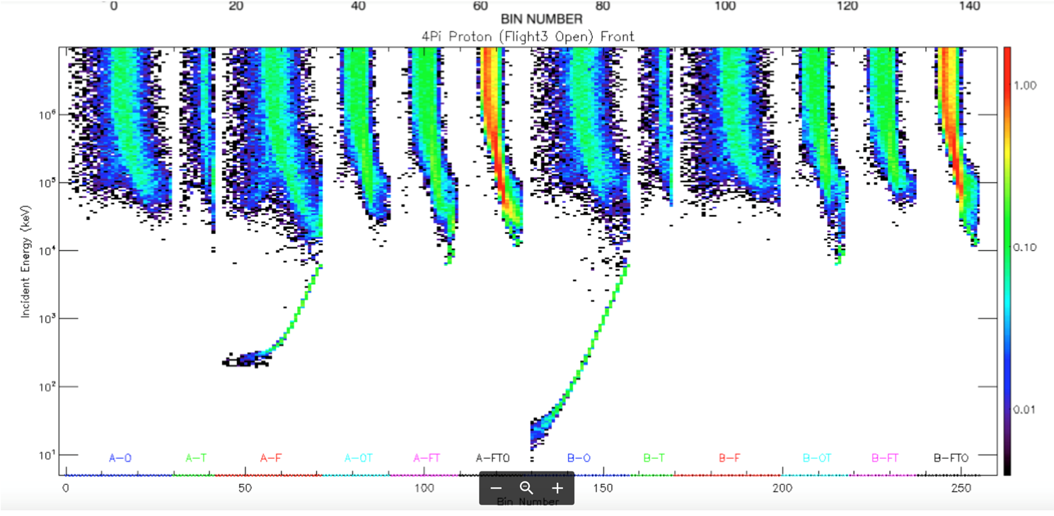
Example of MAVEN/SEP response matrix
Example of MAVEN/SEP response matrix, Expected output in each sample bin is given by:
Rate(B) = RM(E,B) # J(E)
R: 4.13 Product Generation, 4.15 Calibration and Validation; C: SDD

Slide 10
Backup Slides
SWFO-L1/STIS
Heritage: MAVEN/SEP

Slide 11
Primary Driving Requirements
REQUIREMENT | STIS DESIGN
4.6.8 No microswitches STSPEC-163 Micro-switches shall only be used for information only and not use to initiate on-board autonomous activity or as an on-board interlock. | Compliance. The heritage attenuator paddle has been removed and now has a small pixel to enable measurement of high fluxes.
4.3.1 In flight calibration | Compliance. STIS (and heritage instrument) has an internal test pulser and a noise measurement monitor.
4.2.6 Telemetry - Less than 1 Kbit/sec | Compliance. Instrument will have at least 2 modes - Flight mode will have < 1 kBit/sec Engineering/test/calibration mode will have > 1 kbit/sec This will only affect time resolution.
4.2.8 Static Magnetic Field - (B < 40 nT @ 1 meter) Characterized the same way as in MAVEN | To be verified by testing - Heritage THEMIS instrument would meet this requirement. In negotiation to recast this requirement to equivalent field at location of the mag sensor
There are 3 significant changes to the heritage MAVEN/SEP instrument:
Eliminate attenuator (with associated microswitch)
FOV increase (and now single FOV instead of bidirectional
Added small area pixel (and loss of backward looking direction detector)
R: 4.13 Product Generation, 4.15 Calibration and Validation; C: SDD

Slide 12
Environmental Driving Requirements
REQUIREMENT | STIS DESIGN
STIS shall survive vibration loads (STISSPEC 228, STISSPEC 249) | Compliance. Heritage instrument qualified at 14.1grms random vibration (per GEVS)
STIS shall be designed to withstand TID @ L1 over a mission lifetime of 5 years. (STISSPEC 352) | Compliance. Heritage instrument designed for 25krad (met with 100mils Aluminium).
STIS shall be designed such that critical single event effects are <1 per year (STISSPEC 326, 328) | To be verified by analysis - Requirement calls for analysis using CREME96 code.
Thermal Design - STIS Sensor must be biased cold for noise performance (Levied by UCB) | Working with Ball Aerospace to negotiate accomodation. Heritage design has thermally isolated sensor.
No changes to EEE components are expected in order to meet these requirements.
Thickness of chassis is likely to increase from 63mils in heritage design to 100mils for STIS.
R: 4.13 Product Generation, 4.15 Calibration and Validation; C: SDD

