Slide 1
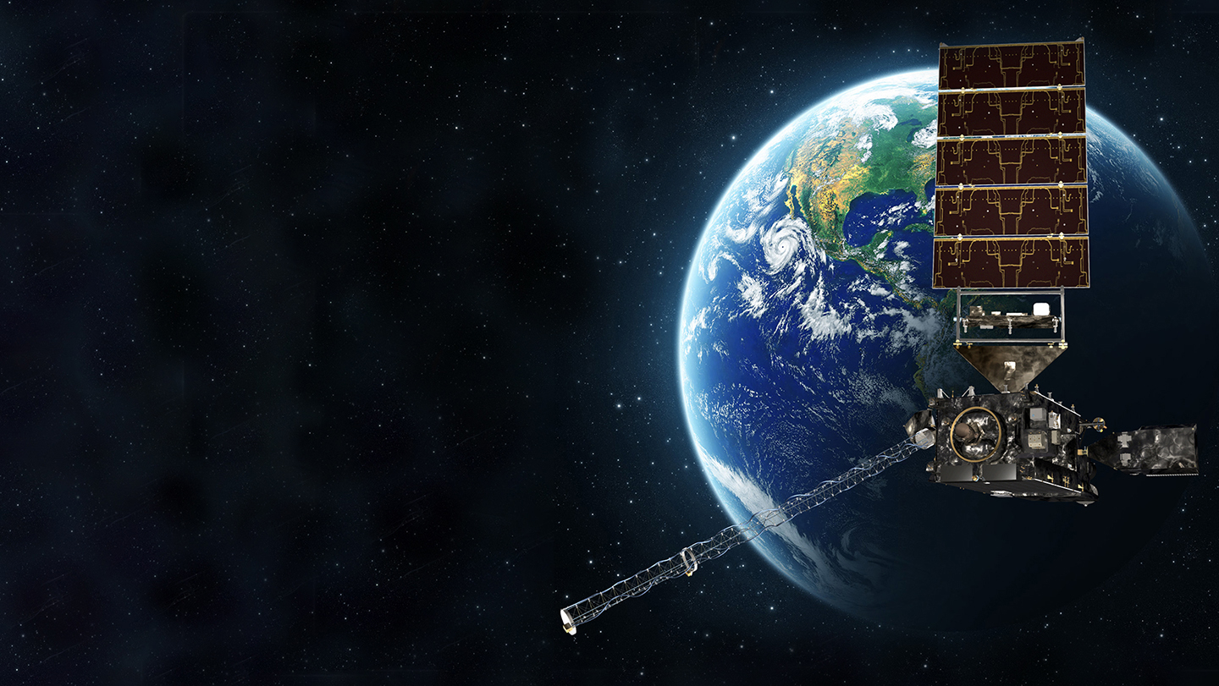




Update on the GeoXO Ocean Color Instrument OCX – Specification and Progress
NOAA’s Satellite Applications Symposium Series
College Park, Maryland
Monday, July 29th, 2024
Amir Ibrahim
NASA Goddard Space Flight Center

Slide 2
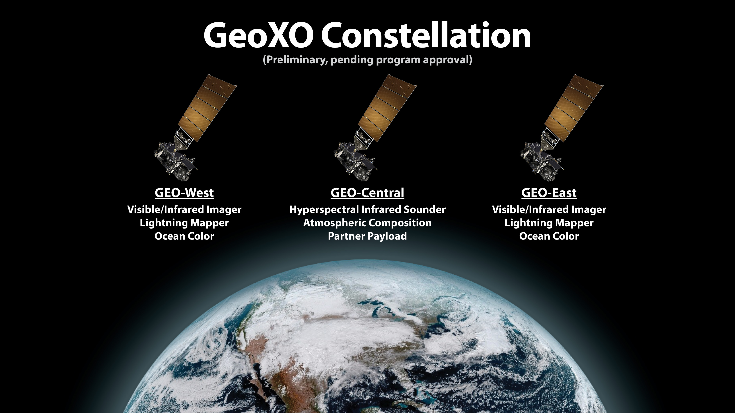

Slide 3
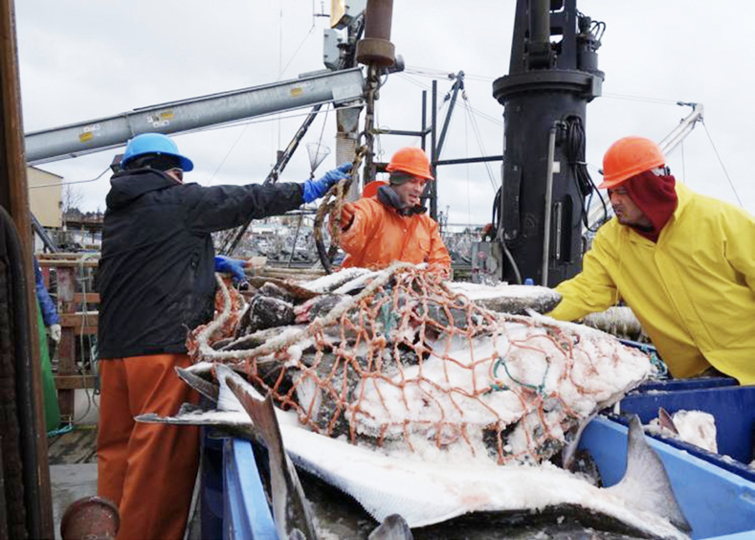
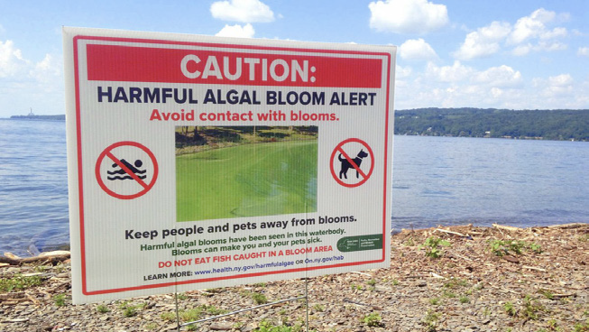
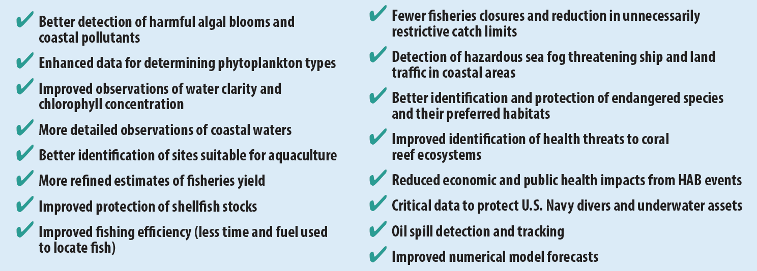

OCX objectives and NOAA’s operational needs
OCX Fact Sheet

Slide 4
Timeline to 1st GeoXO Launch
User Reqts
WG
(XORWG)
Convened
NOSC
Endorses
Observation
Set
GeoXO-I1
Launch
We are here
Form.
Auth.
KDP
A
KDP
dA
Contract
Awards
KDP
B
KDP
C
KDP
D
KDP
E
MCR
SRR
MDR
PDR
CDR
SIR
ORR
FY20 | FY21 | FY22 | FY23 | FY24 | FY25 | FY26 | FY27 | FY28 | FY29 | FY30 | FY31 | FY32 | FY33
MS0
MS1
MS2/3
(DOC Baseline)
Congressional
Baseline
Ops
Pre-formulation
Formulation
Implementation
Implementation contracts:
Imager: L3Harris
Sounder: BAE
Ocean Color: BAE
Atmo. Comp: BAE
Spacecraft: LM
- Lightning Mapper: blackout

Slide 5
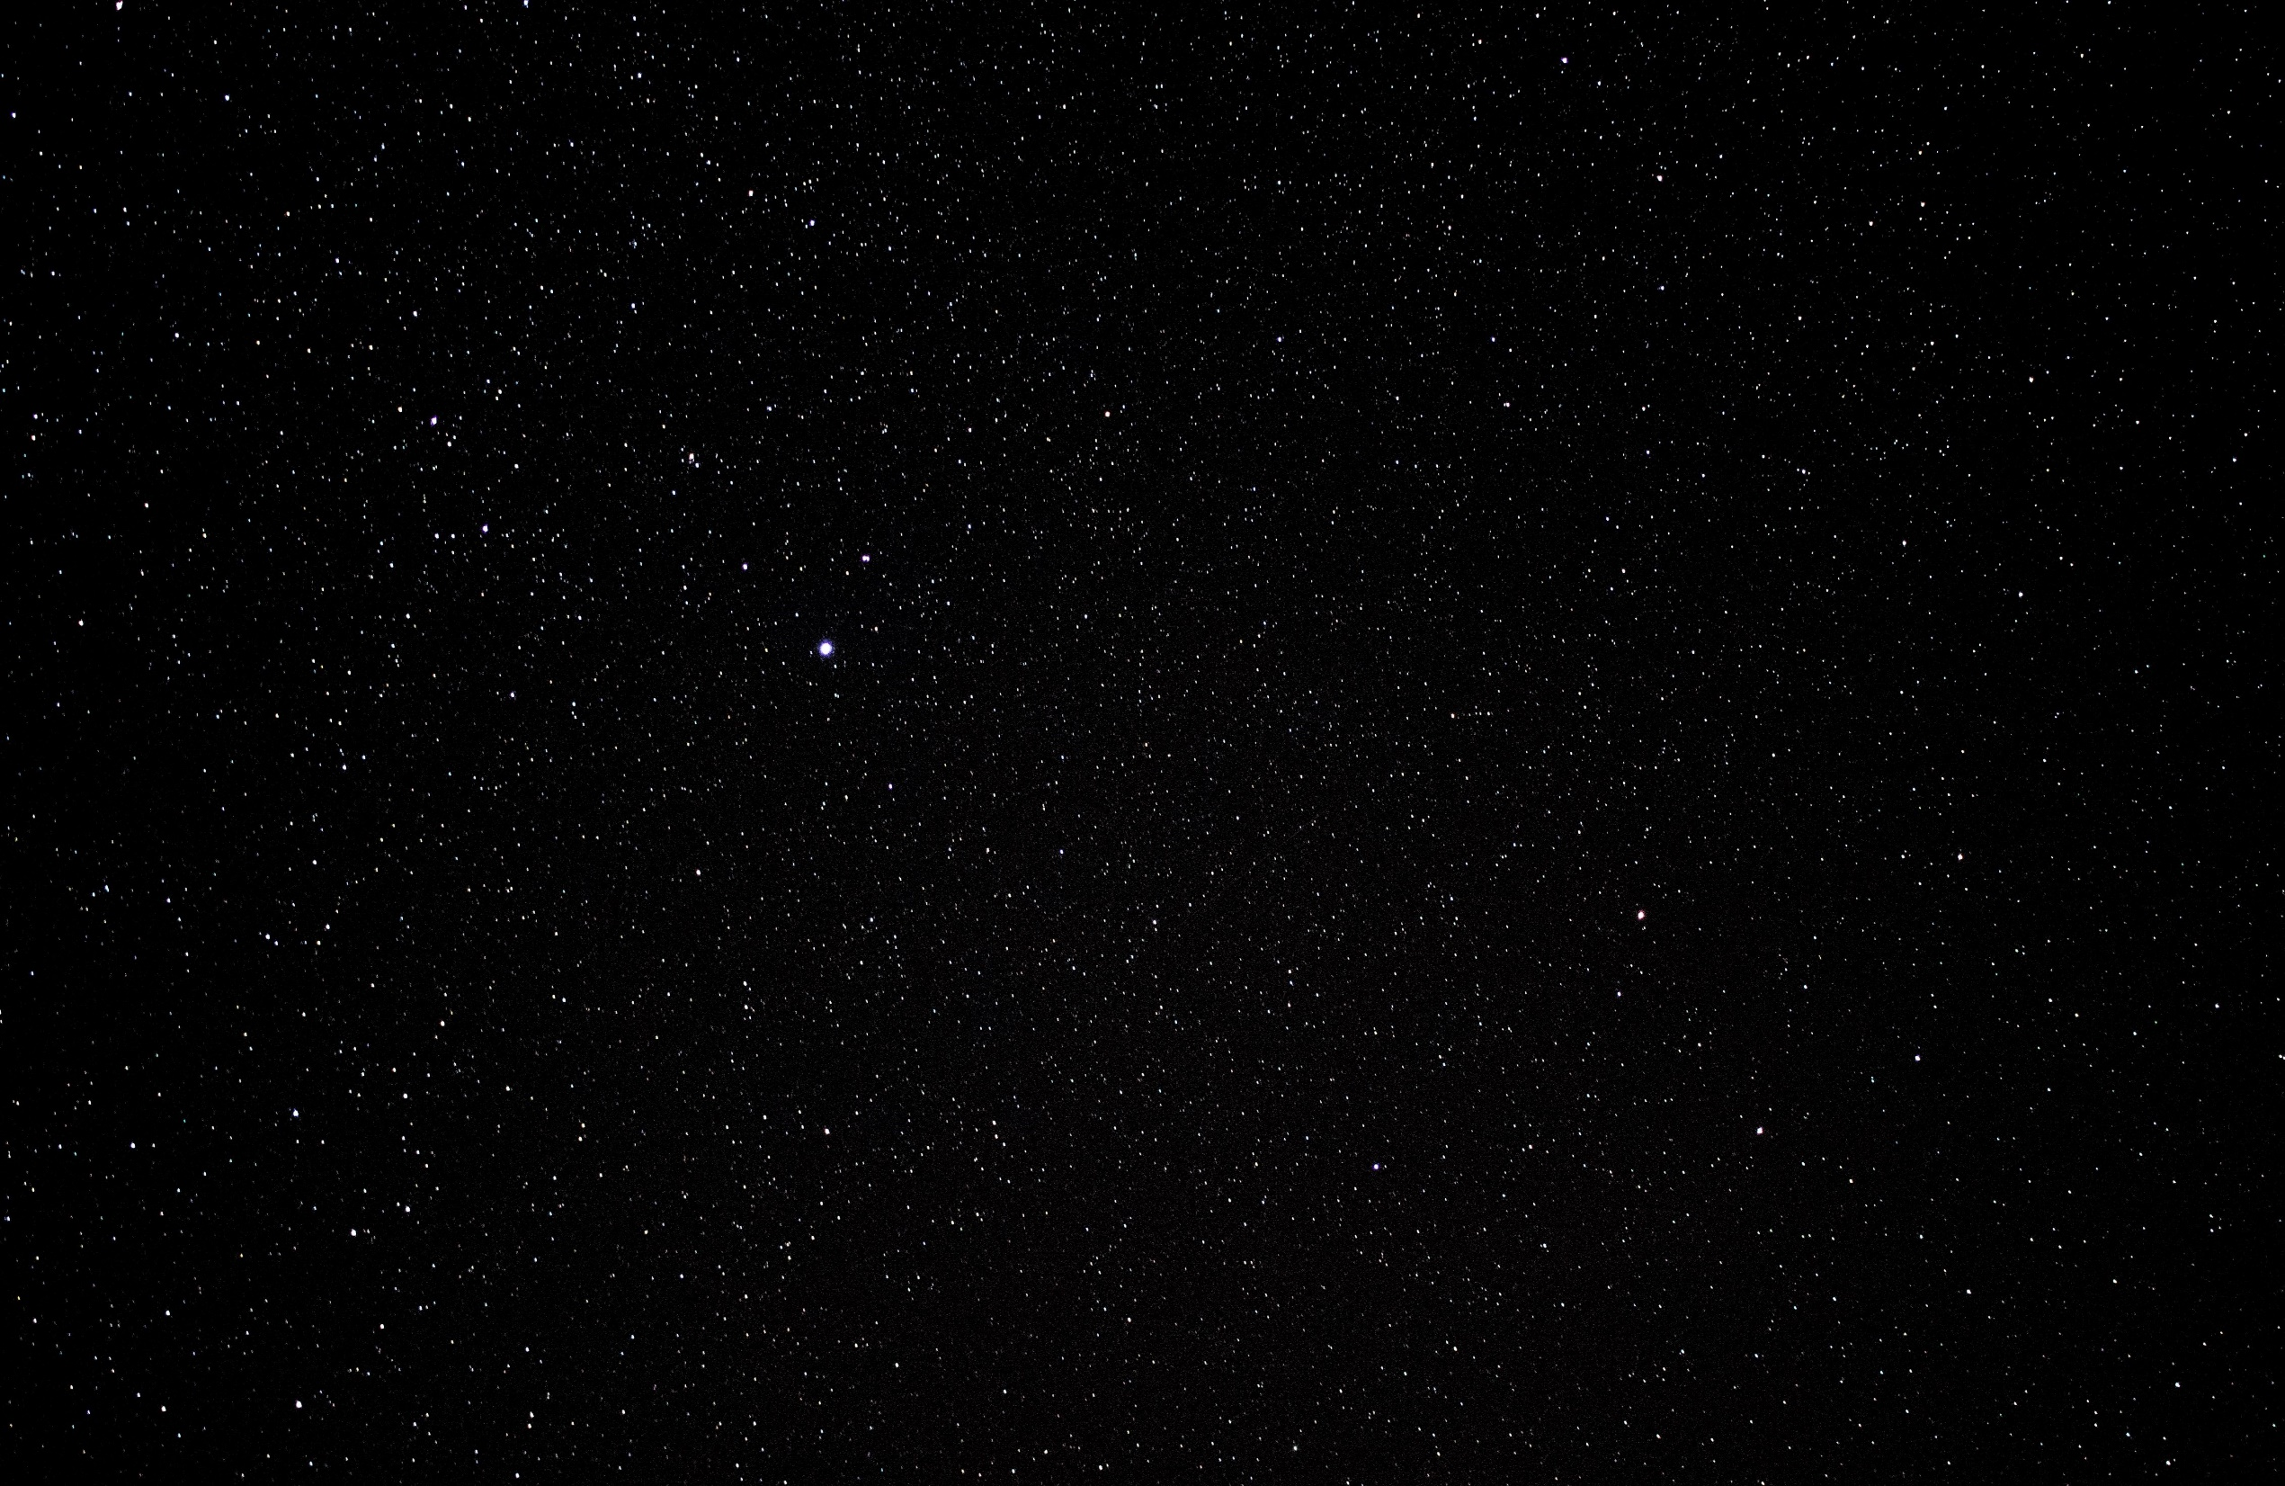
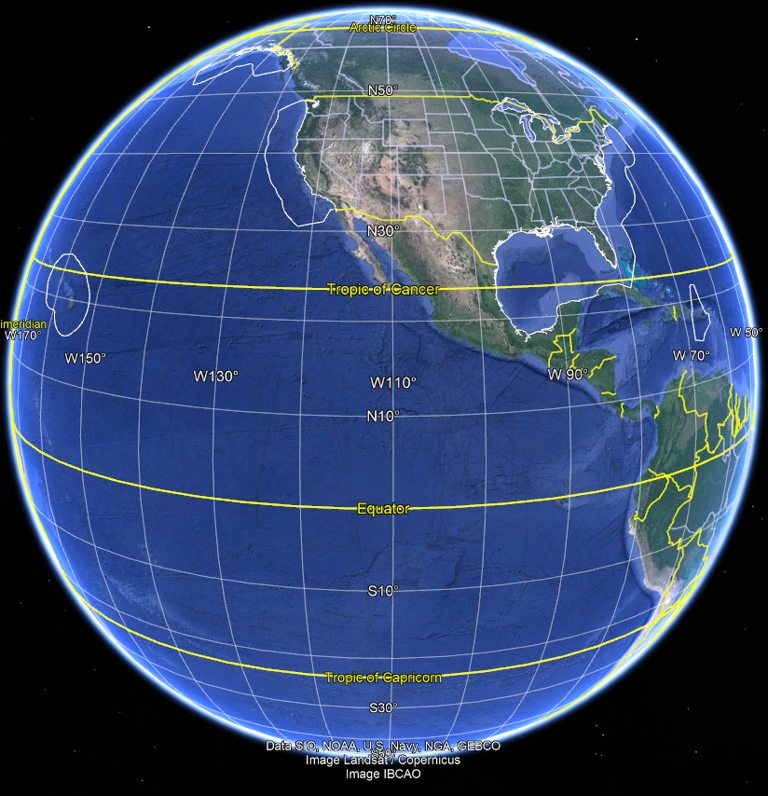
OCX – next gen ocean color sensors aboard GeoXO
Coverage:
EEZ East Region plus Great Lakes, and EEZ West Region
Flexible and Efficient Imaging Pattern
Field of Regard 16.3° – Earth’s Full Disk
137°
75°

Slide 6
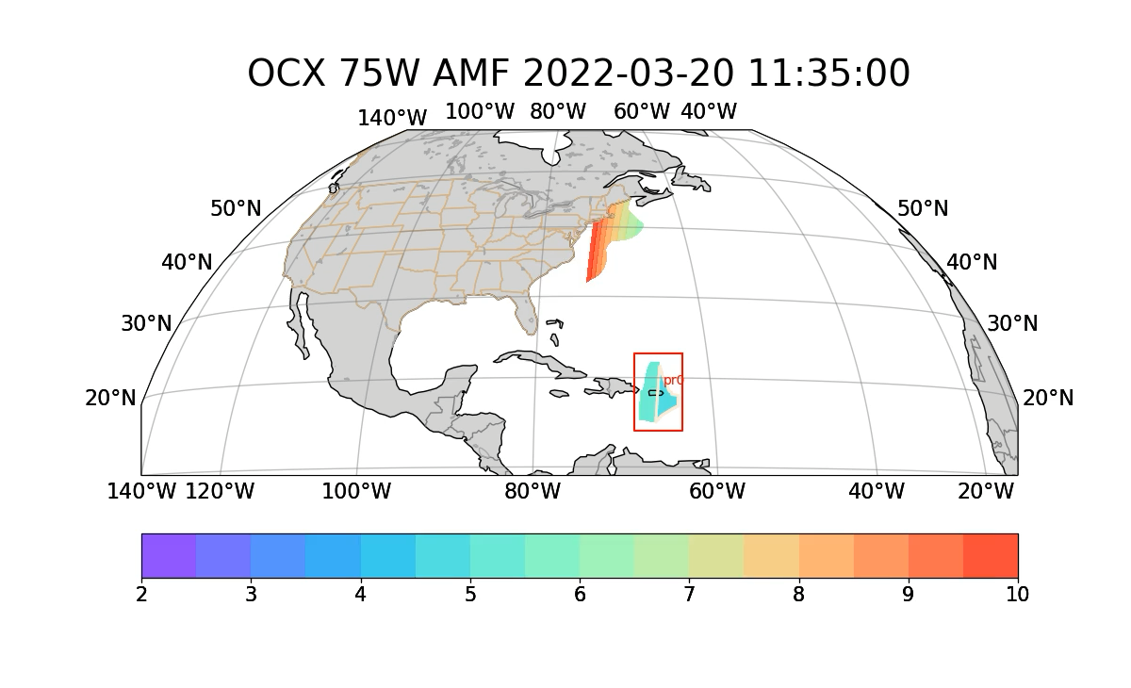
OCX Scan Rate and Pattern
2 hours refresh rate
”scan” - multiple slit data collection with FOV: 0.79 deg x 1.14 deg Duration: 10 min per scan
East EEZ + GL is covered by 12 scans
Air Mass Factor (AMF)
Scanning Algorithm:
1. Impose AMF or other availability criterion, here AMF<5 (shown with a tan contour on the video below)
2. Determine start and end times of availability for each pixel within the EEZ
3. Scan at fixed locations (ROIs), as more than 12% of the ROI becomes available.
The availability of the West coast EEZ is shown for reference, and can be included in future exploration of scanning patterns.

Slide 7
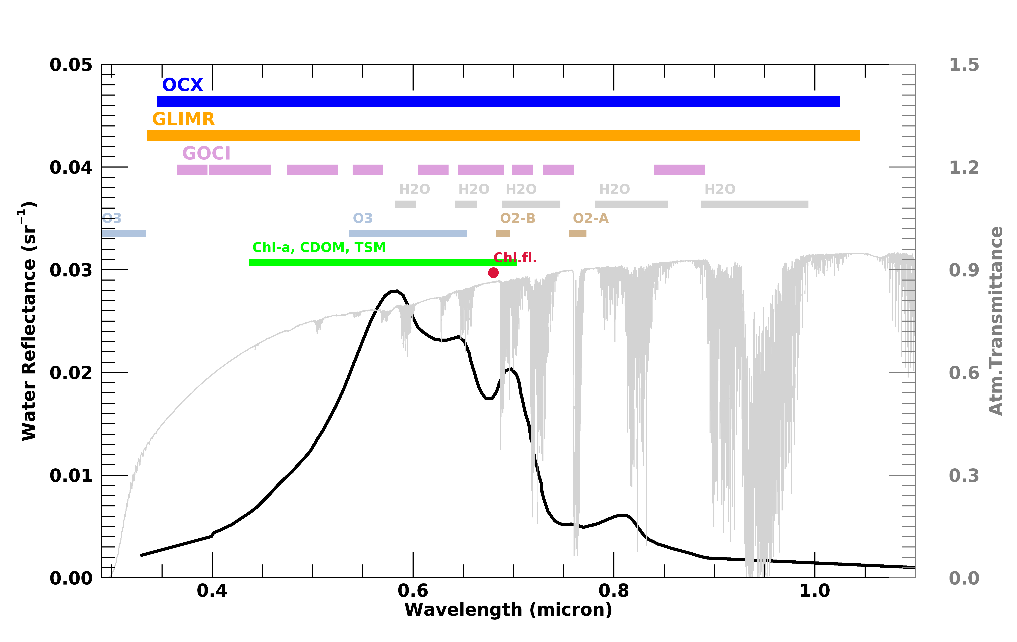
Channel Definitions, SNR, Dynamic Range
Requirements:
Hyperspectral coverage 0.35 – 1.02 µm
Spectral resolution: 10 nm in the fluoresce region, 20 nm elsewhere
SNR: 400:1 for 350nm-390nm
600:1 for 390nm-890nm
DR: No saturation
Center wavelength knowledge <0.1 nm
CBE baseline specs:
Spectral range: 0.348 – 1.05 µm
Resolution: <5 nm 0.348-0.55 µm, <10 nm 0.55-0.7 µm, <20 nm 1.05 µm
SNR: Significant margin ~2000 at 0.45 µm

Slide 8
Spatial Resolution and Sampling
GeoXO West
GeoXO East
Spatial Resolution: 300 meters
Modulation Transfer Function MTF ≥ 0.20 @ 0.6 km/cycle
Image Navigation and Registration (INR): Star Sensing
Frame to Frame INR: < 6.3 µrad

Slide 9
Radiometric Performance Requirements
On-board Calibration System (solar calibration/diffuser)
Absolute Accuracy Requirement: <2%
  Before System Vicarious Calibration (<0.2% after SVC)
<0.5% calibration drift over the lifetime of OCX
<0.2% RMS repeatability requirement
Minimal channel-to-channel and pixel-to-pixel cross talk < NEDN
<3% Polarization Sensitivity
<1% non-linearity before calibration

Slide 10
What’s next?
Continue working with BAE on maturing their design.
Establish a calibration working group and:
  Assess lessons learned from PACE and GLIMR
  Involve the community in OCX calibration activities, particularly SVC
Provide regular updates to the community on OCX progress.
Pass NASA reviews (SRR in December)!

Slide 11
Questions

Slide 12
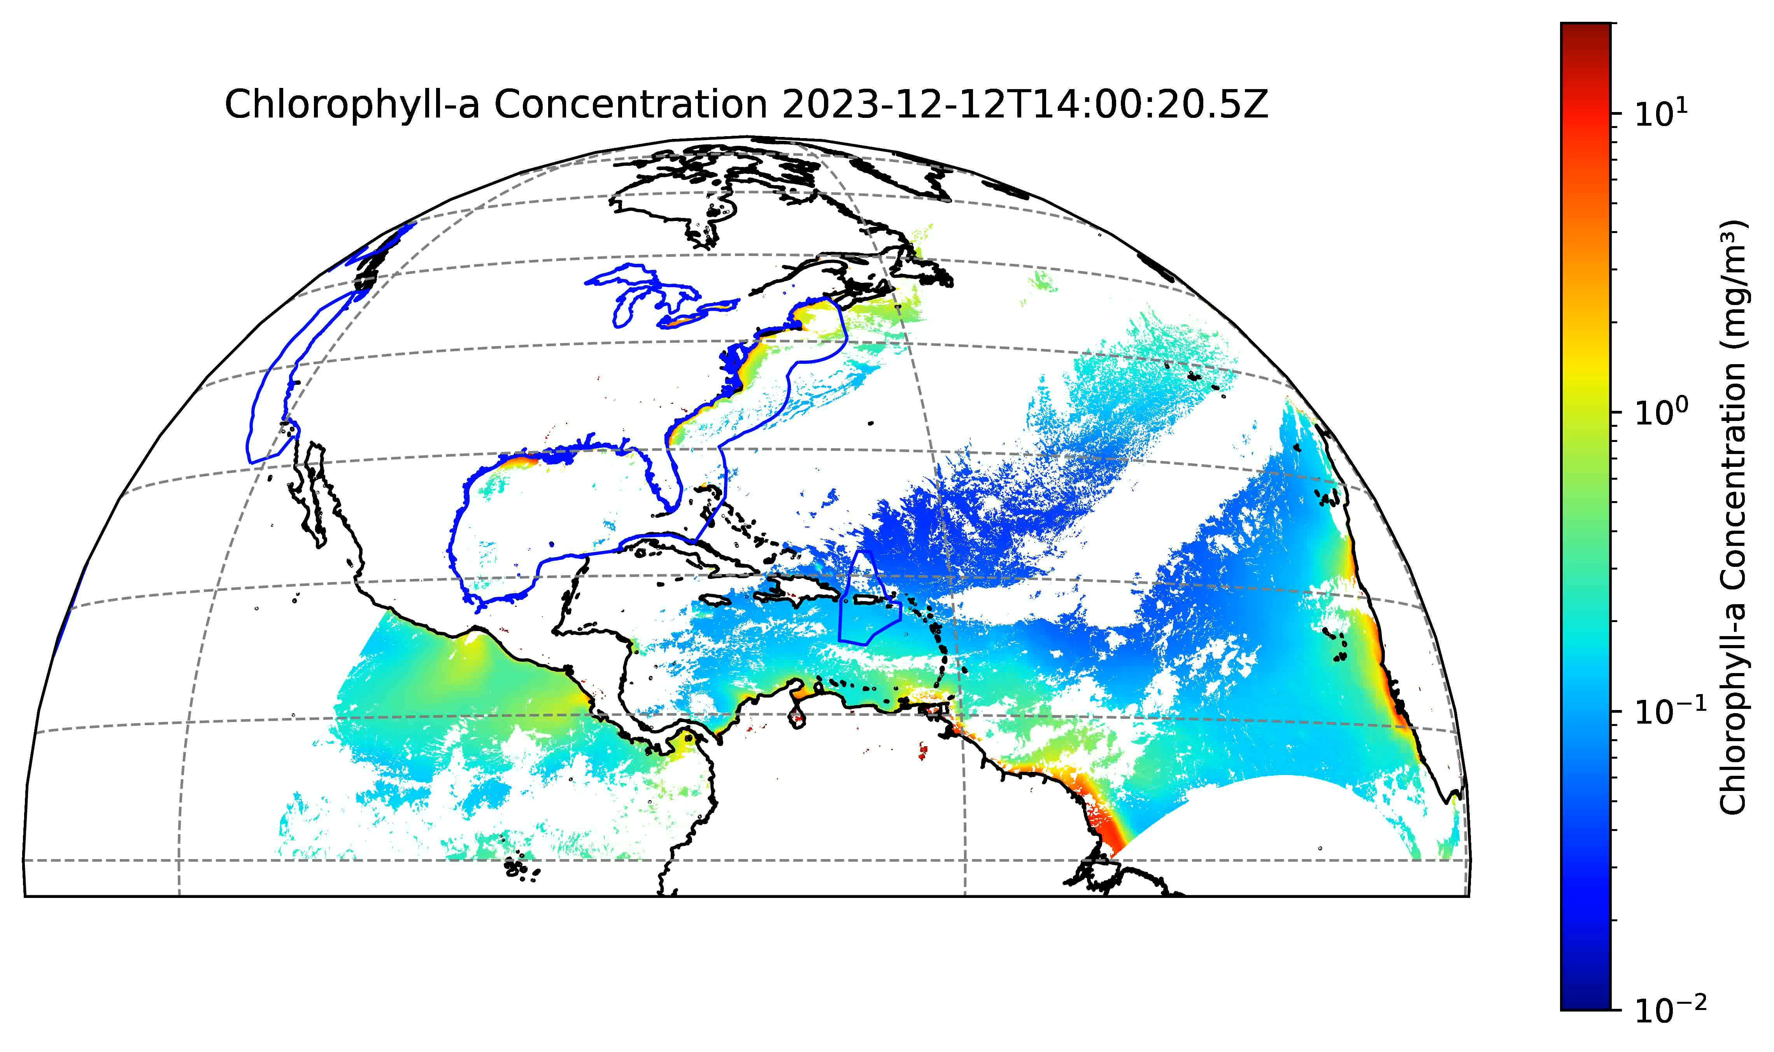
Simulations of Cloud Coverage interference with ocean color
OCX will observe the EEZ and Great Lakes

Slide 13
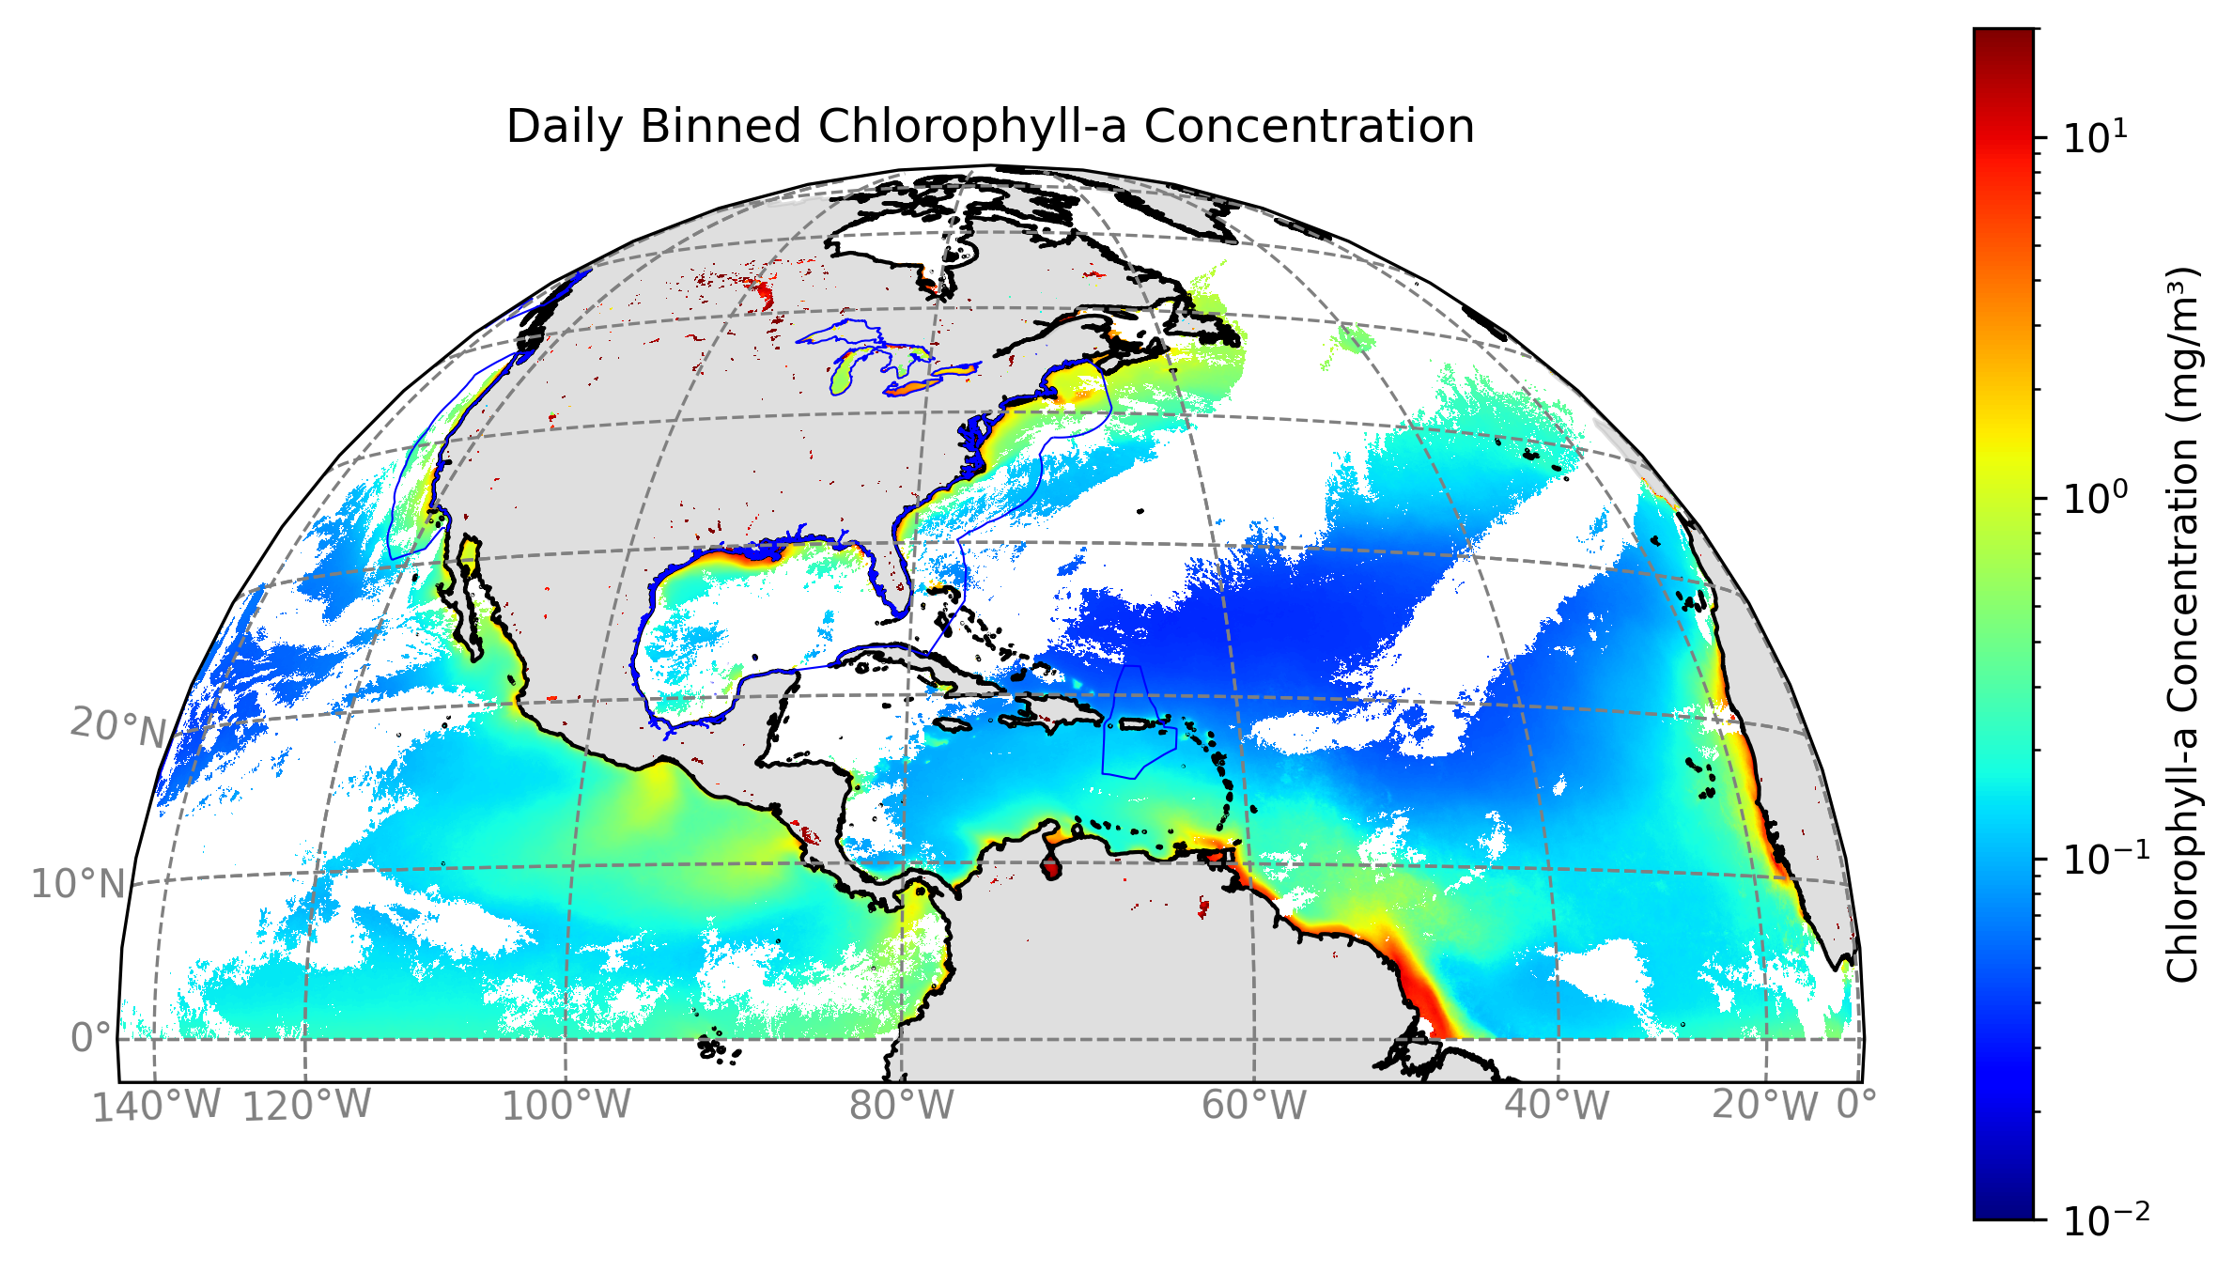
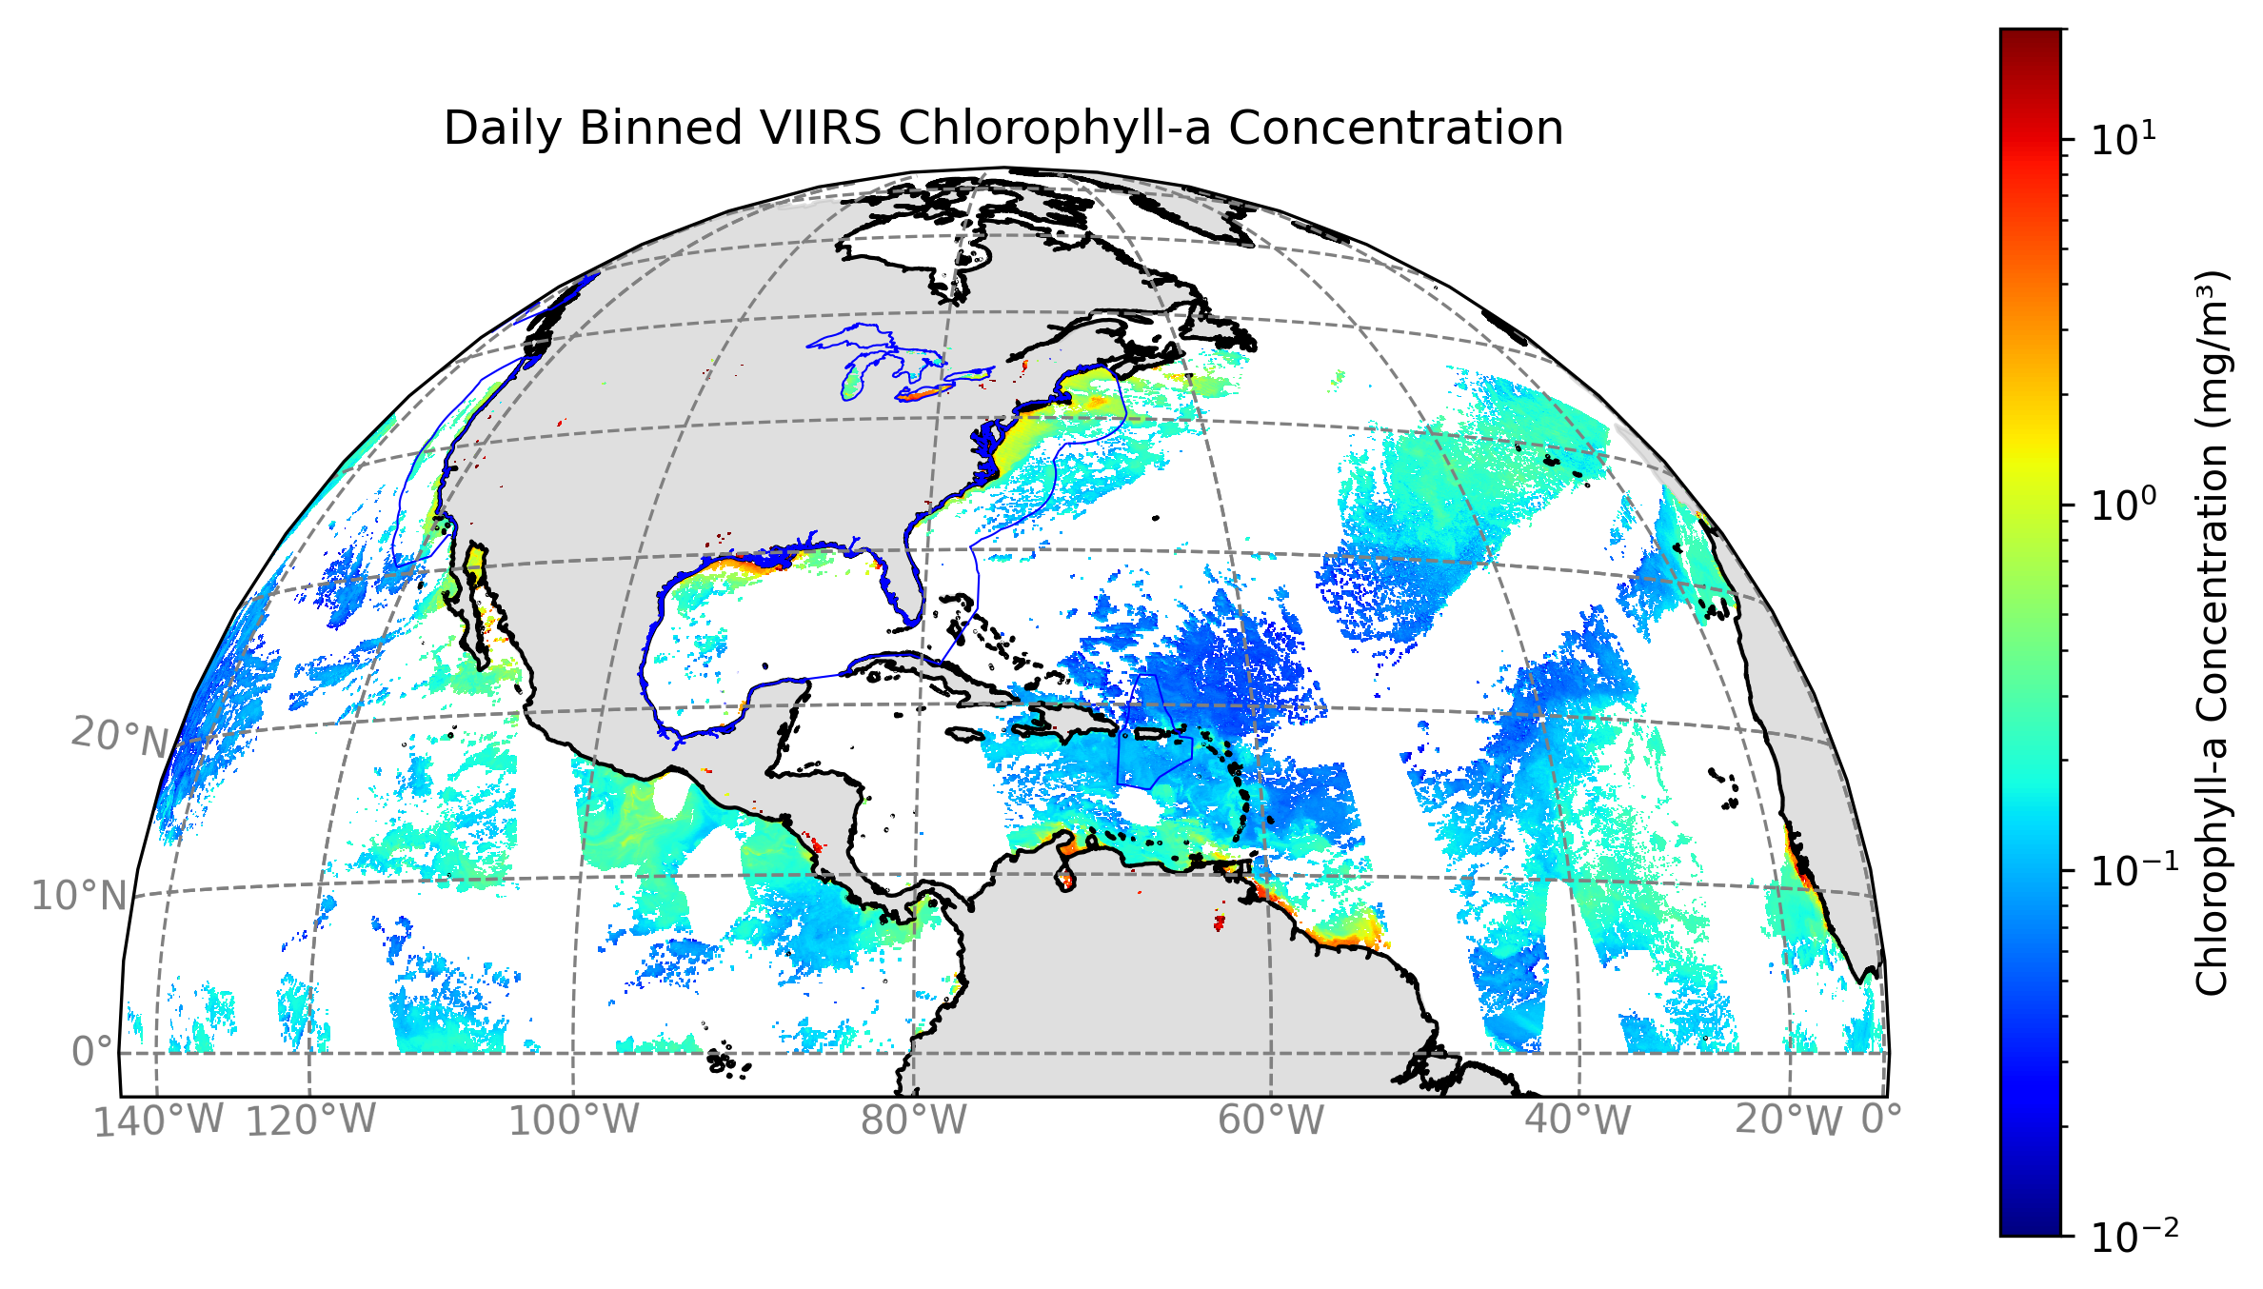
Cloud Free Observations: GEO vs LEO
Binned hourly GEO observations of the Northern Hemisphere
EEZ and Great Lakes
GeoXO-OCX will provide more opportunities to capture cloud-free observations over the EEZ.
Cloud coverage is typically 67% of an arbitrary scene.
Over the course of a day, a polar-orbiting satellite can currently image ~15% of the ocean due to cloud cover and glint.
This analysis is done for the Northern Hemisphere and not the EEZ for one arbitrary day.
We extended this analysis to 90 days in the EEZ and for different seasons for statistically significant results.
We utilize the ABI cloud mask for analysis.
Binned daily LEO observations of the Northern Hemisphere

Slide 14
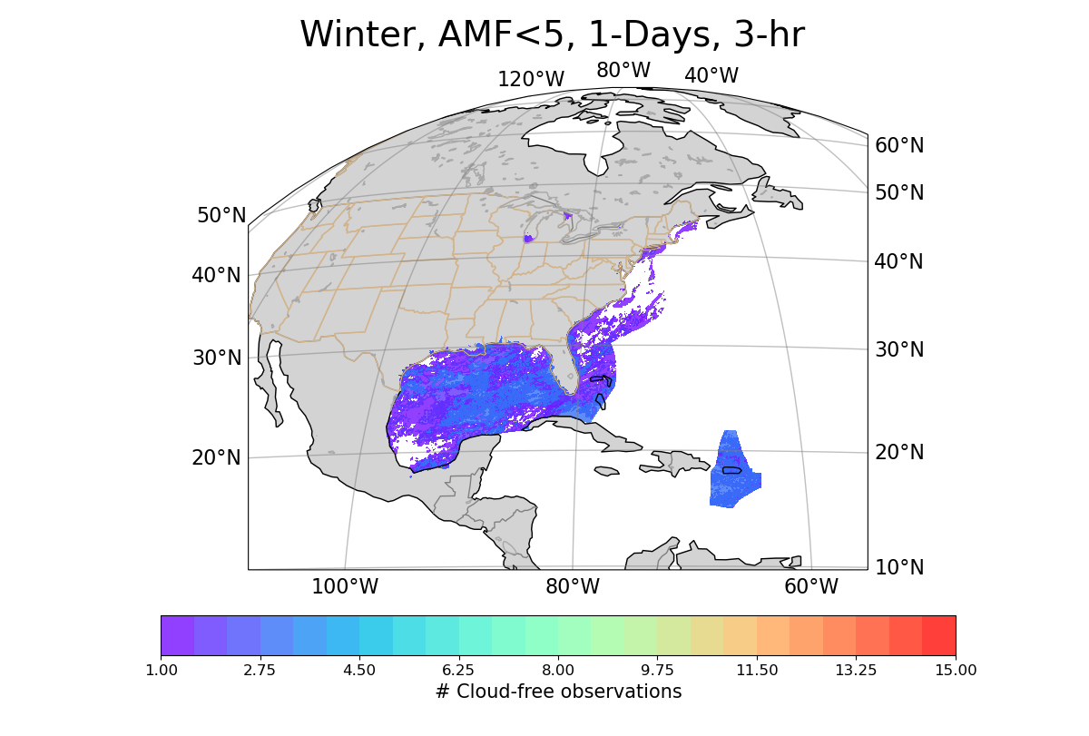
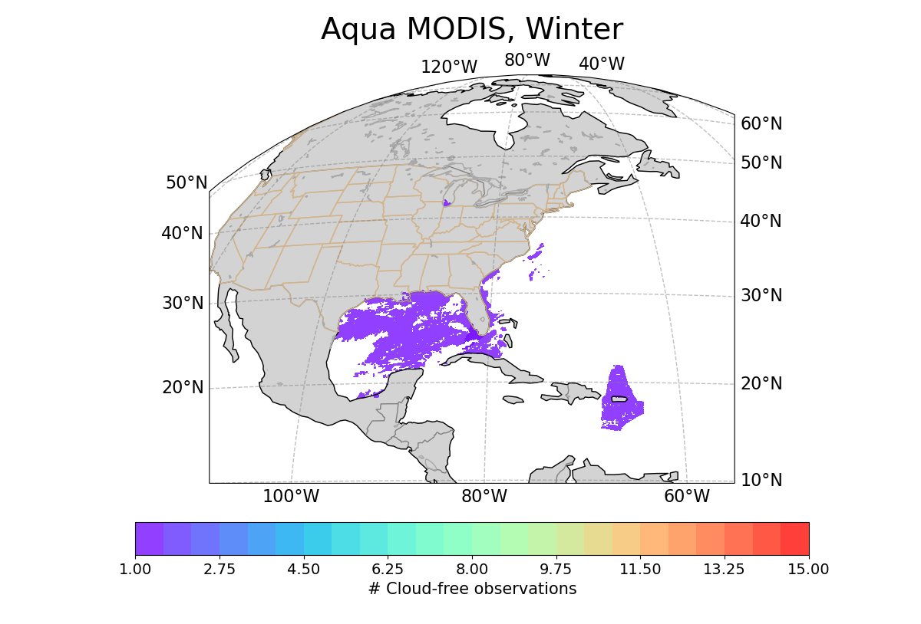
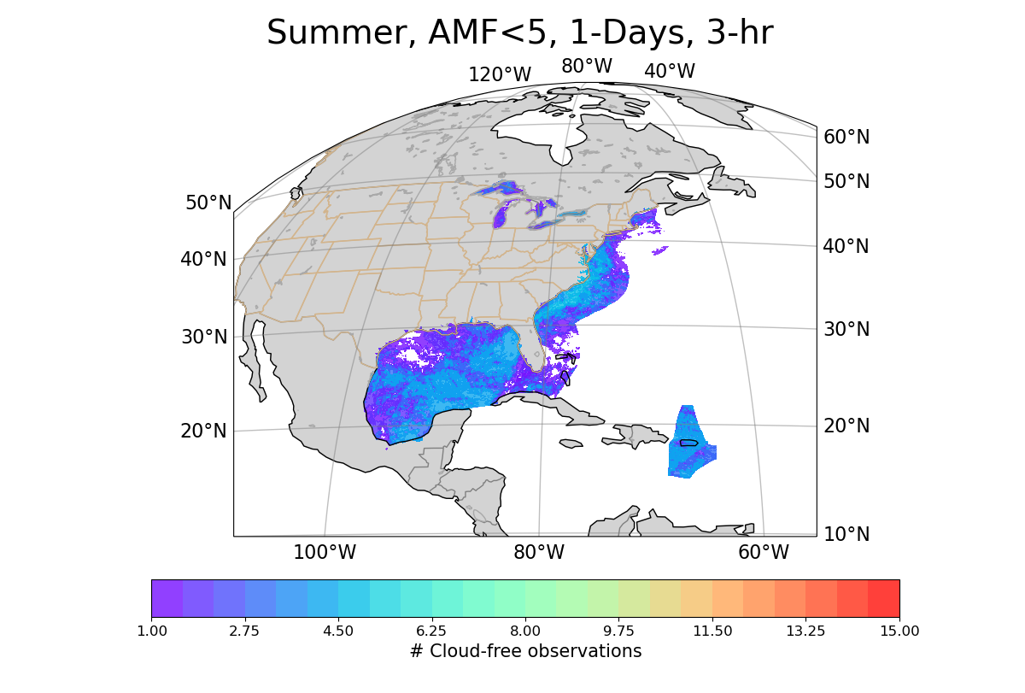
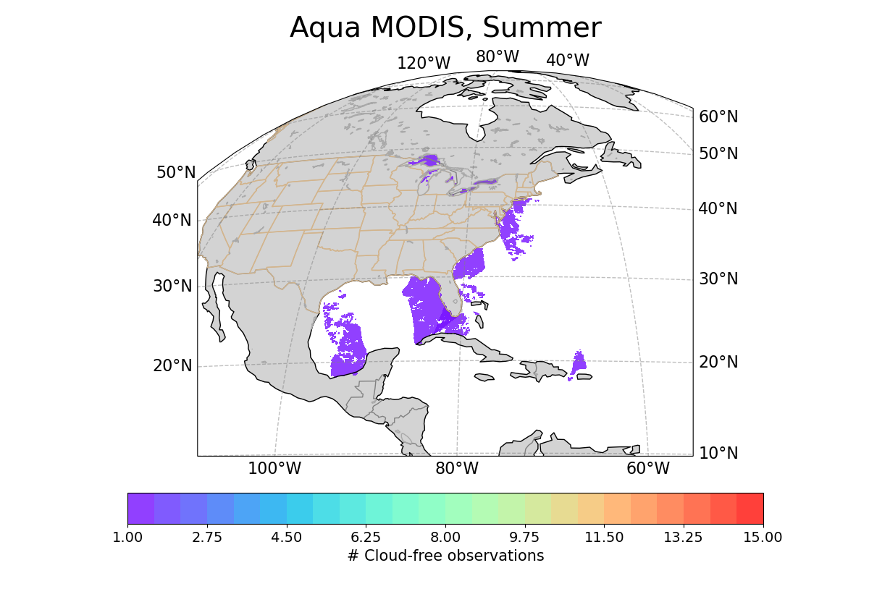
Daily observations of GEO vs LEO within the EEZ East at different seasons
GEO
LEO
Winter
GEO
LEO
Summer

Slide 15
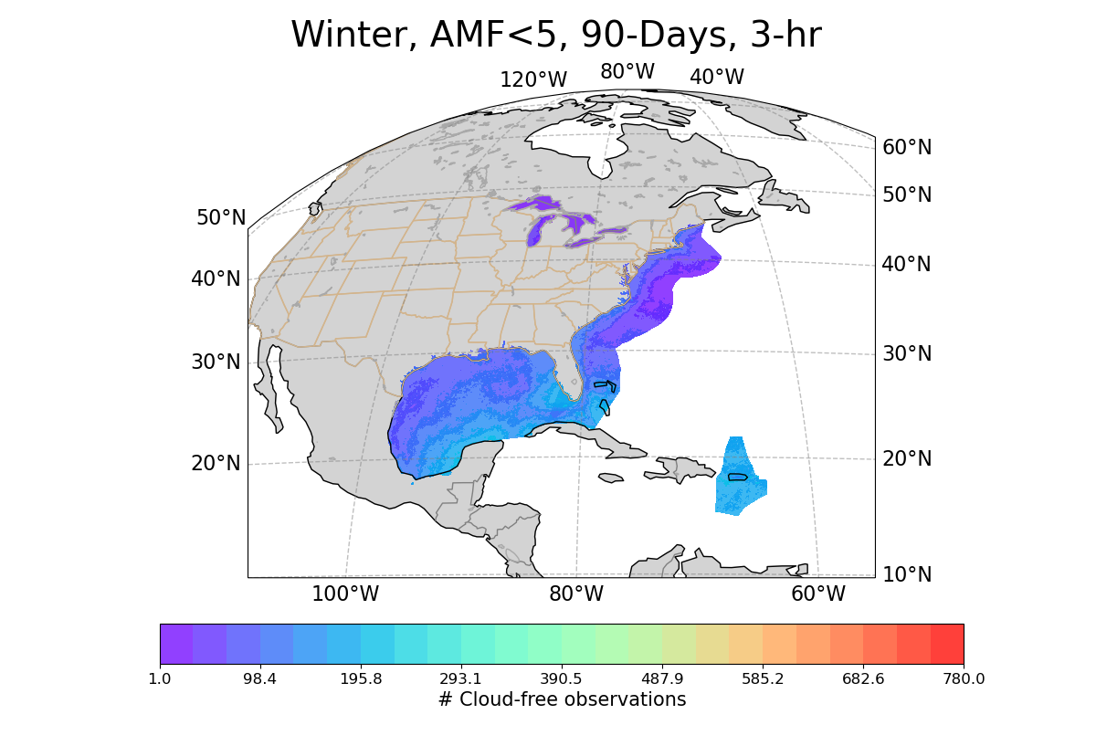
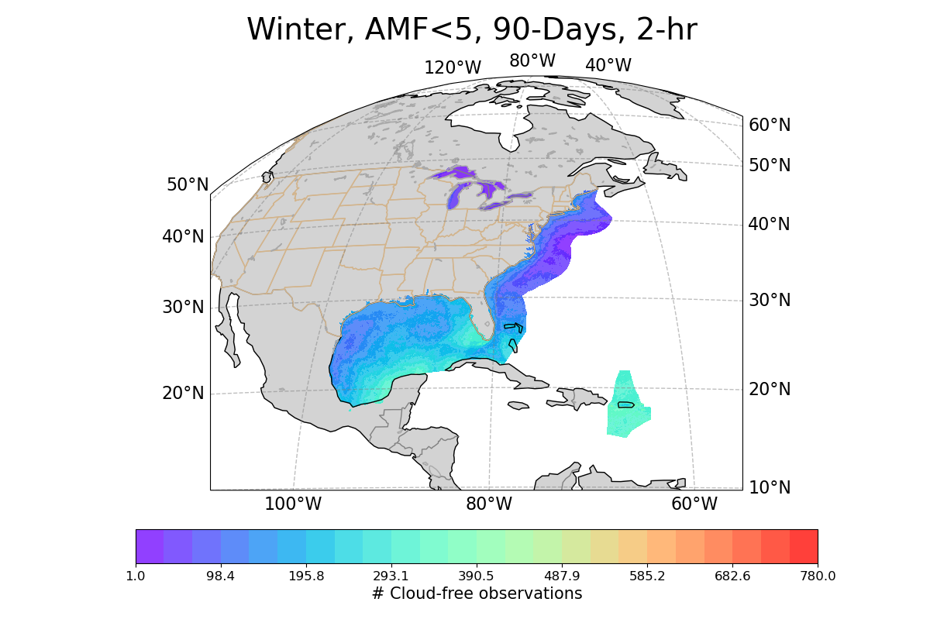
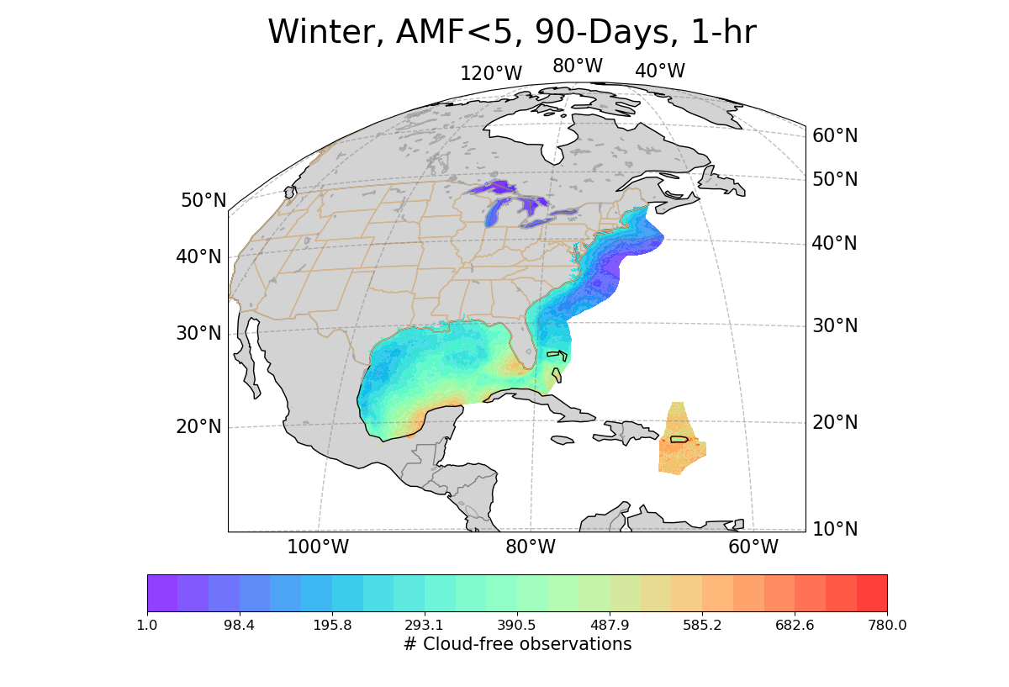
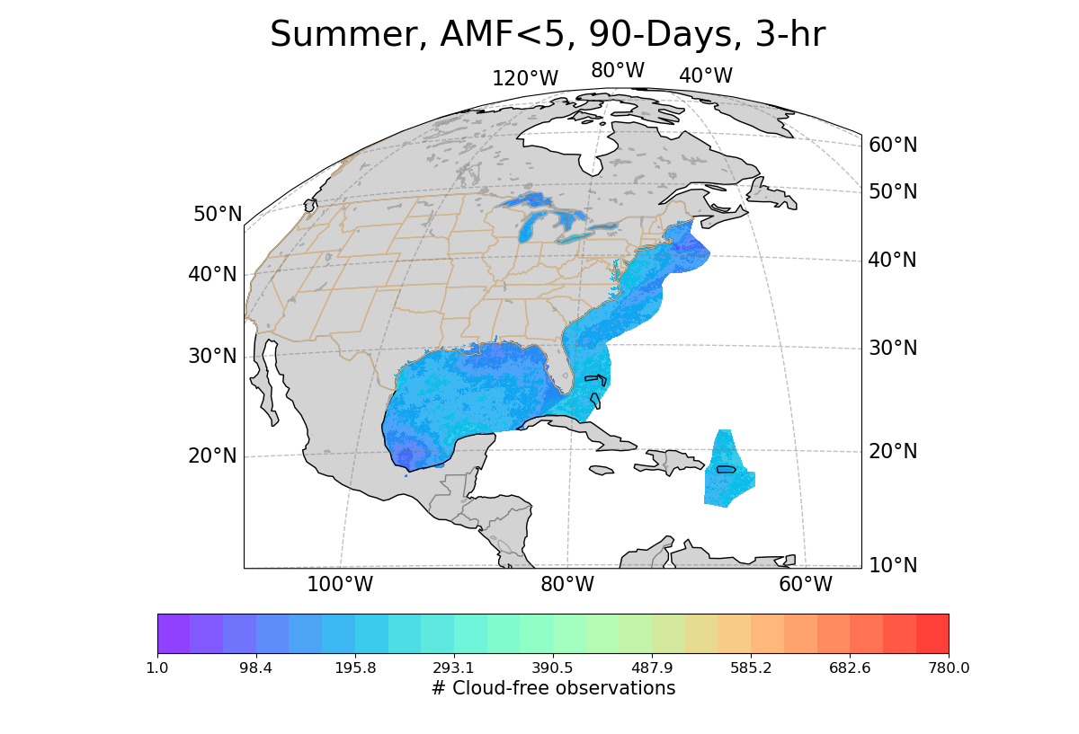
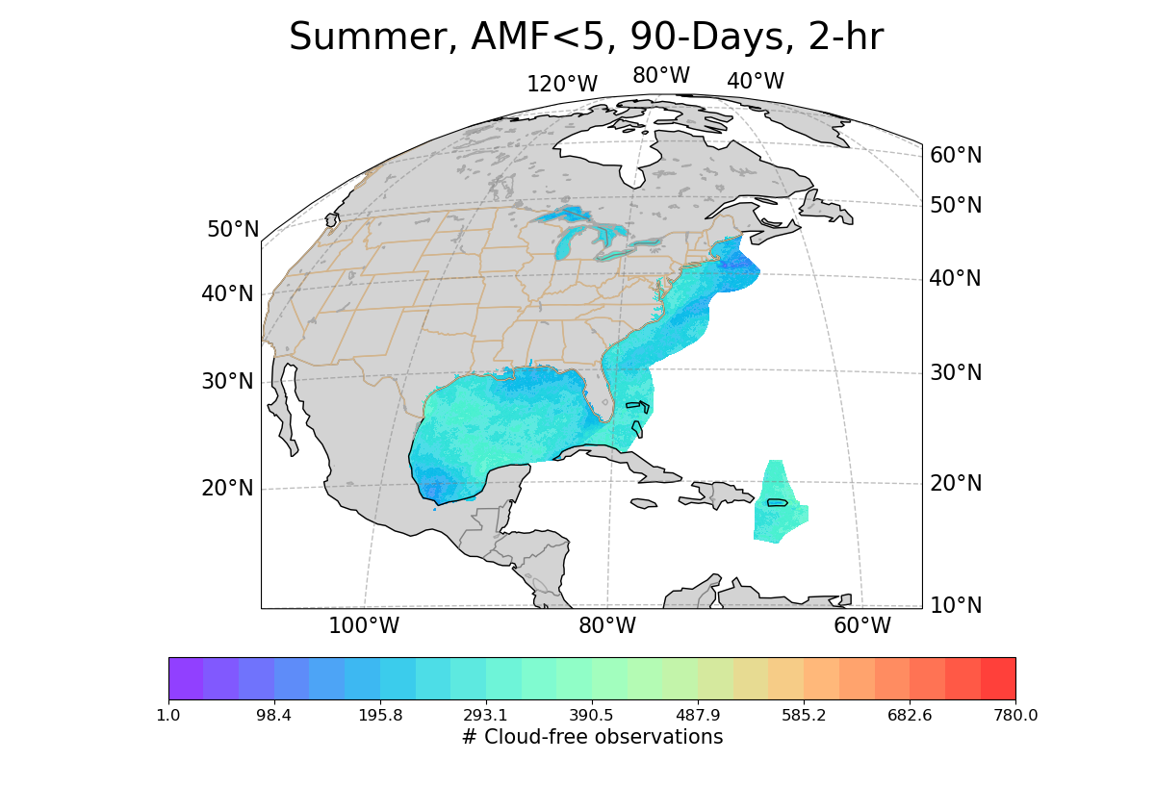
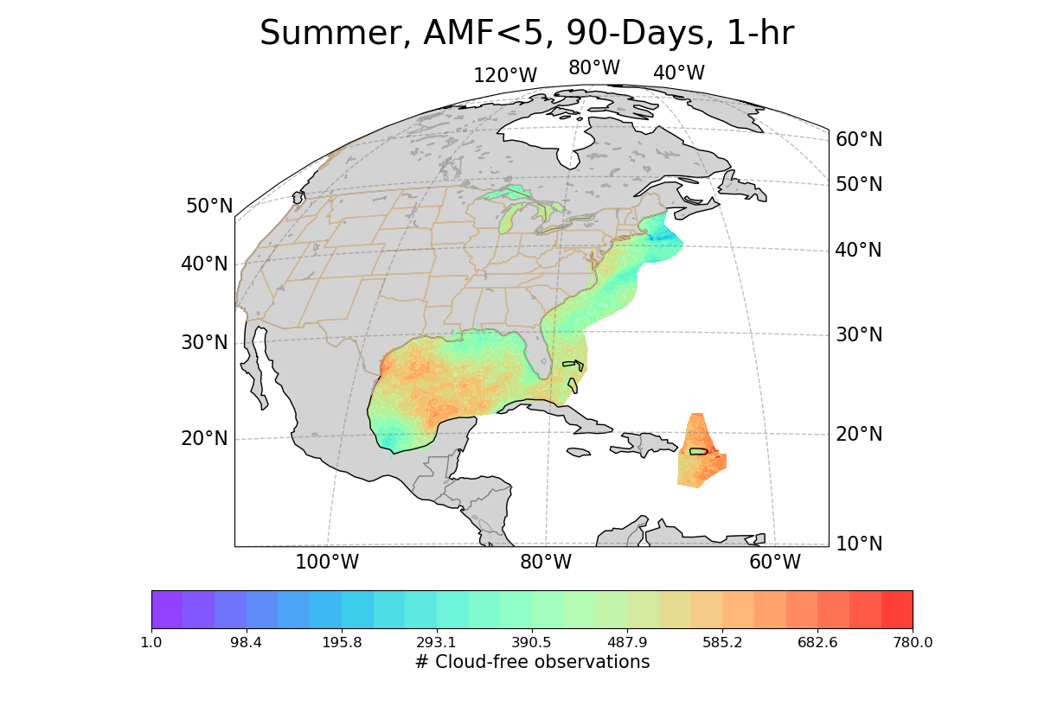
90-Day cloud-free observations for 1-, 2-, and 3-hour revisit time
Increasing Cadence of Observations

Slide 16
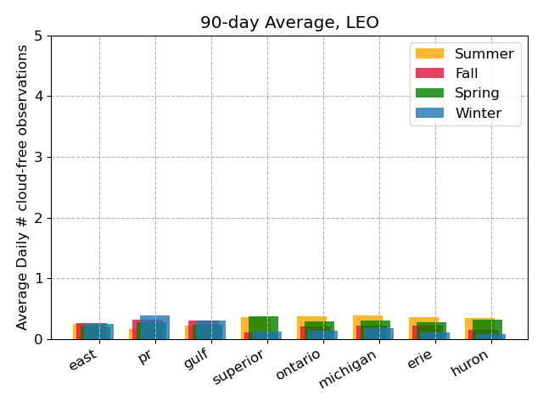
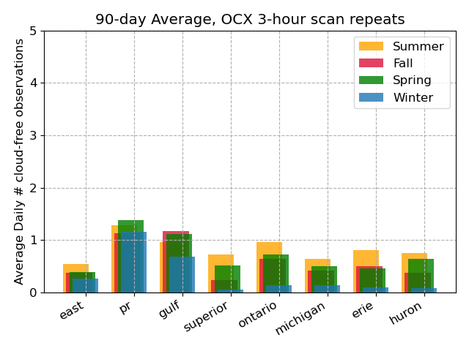
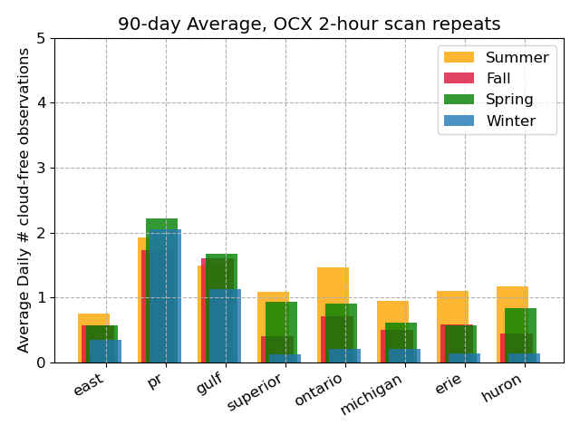
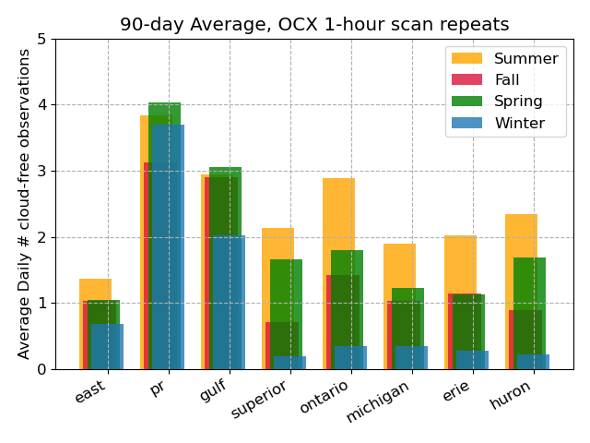
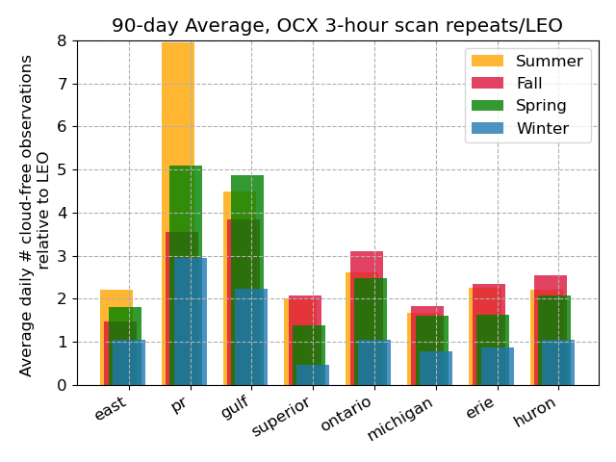
Average Number of Independent Daily Observations over a 90-Day Period
The average (over all pixels in the EEZ) number of cloud-free observations per day is derived for each season.
The results are shown in the left panel for LEO and GEO at 3,2 and 1 hr repeats.
The lowest cadence GEO instrument shows overall better coverage than LEO.
In the bottom right plot, the 3-hr cadence GEO daily observations are normalized by the number of LEO observations
Winter: 1.6x Spring: 3.2x Summer: 3.4x Fall: 2.6x

Slide 17
Summary
OCX is planned for NOAA's next generation of geostationary environmental satellites, GeoXO, focusing on observing ocean biology, chemistry, and ecology.
OCX to assess ocean productivity, ecosystem changes, water quality, seafood safety, and hazards like harmful algal blooms (HABs), with analysis every three hours at 300 meters GSD.
OCX offers more frequent and comprehensive ocean and coastal condition observations than current sensors, with at least three-hourly updates.
Frequent observations allow for cloud avoidance and increased ocean color coverage necessary to meet NOAA’s needs (see also J. Joiner’s talk today at 5:30 EST).
The hyperspectral nature of OCX allows for a wide spectrum of light analysis, aiding in distinguishing phytoplankton types and tracking algal blooms.
The first satellite launch with OCX is planned for 2032.

Slide 18
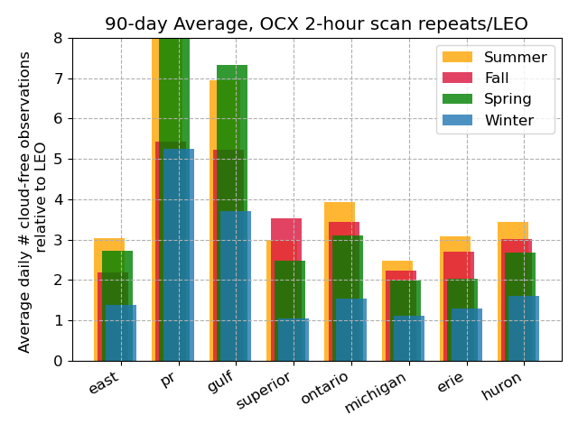
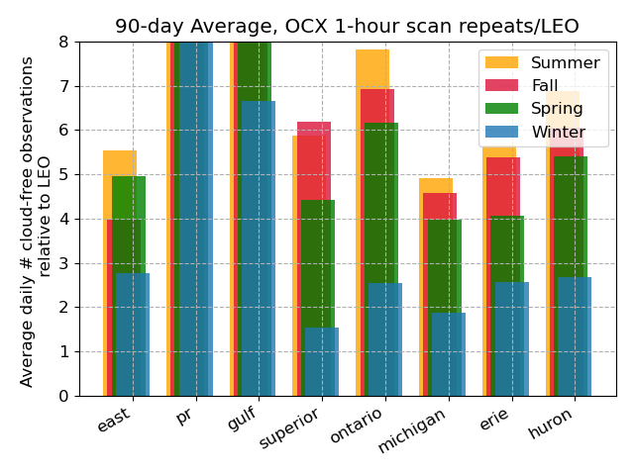
Appendix
Daily Average OCX Observations Relative to LEO (from the 90-day average)
The lowest cadence GEO instrument shows overall better coverage than LEO. In plots below the 3-hr (left), 2-hr (middle), and 1-hr (right) cadence GEO daily observations are normalized by the number of LEO observations
Winter: 1.6 Spring: 3.2 Summer: 3.4 Fall: 2.6
Winter: 2.5 Spring: 4.8 Summer: 5.1 Fall: 3.6
Winter: 4.6 Spring: 8.8 Summer: 9.8 Fall: 6.6

